Slide 1

Introduction to Data Analysis in R
BIOL90041
Week 2
Dr. Kristoffer Wild

Slide 2
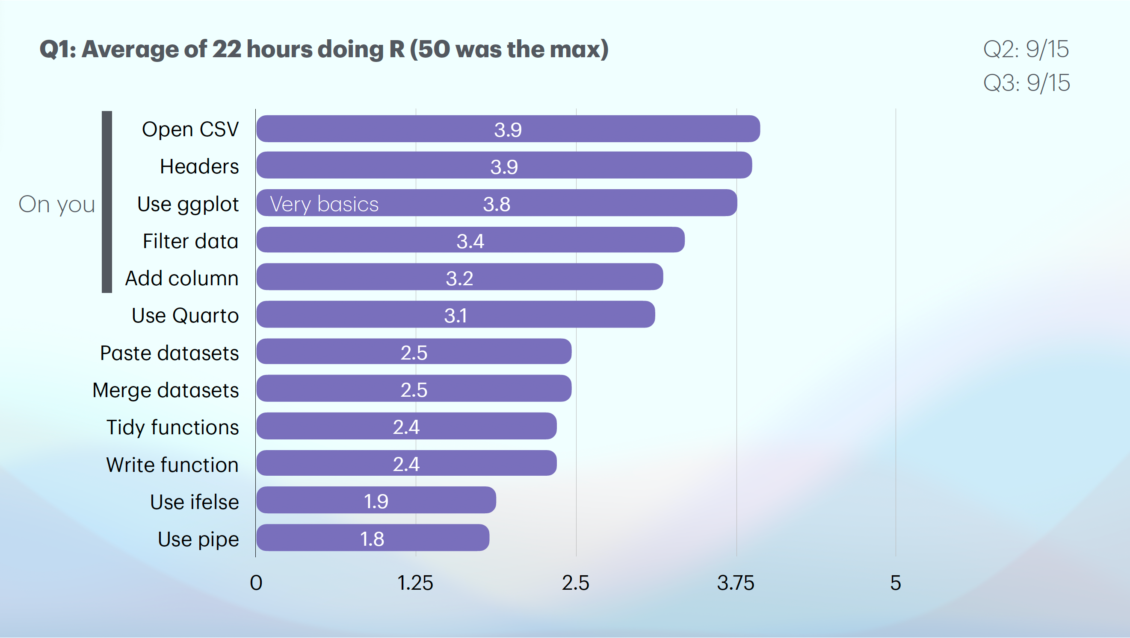
Notes:
So here are some of the results from the survey we asked you to do.
Those of you that answered it thank you.
You can see we have a pretty wide variation in R users, this is okay.
I will spend this lecture to get you guys on the basics of coding
by introducing R and simple functions but then the next two lectures we will dig into your projects and
move into more data manipulation and wrangling.
So those of you that are more on the comfortable side of things, just hang tight.
You also may learn some tricks in this weeks content that you may not have known

Slide 3



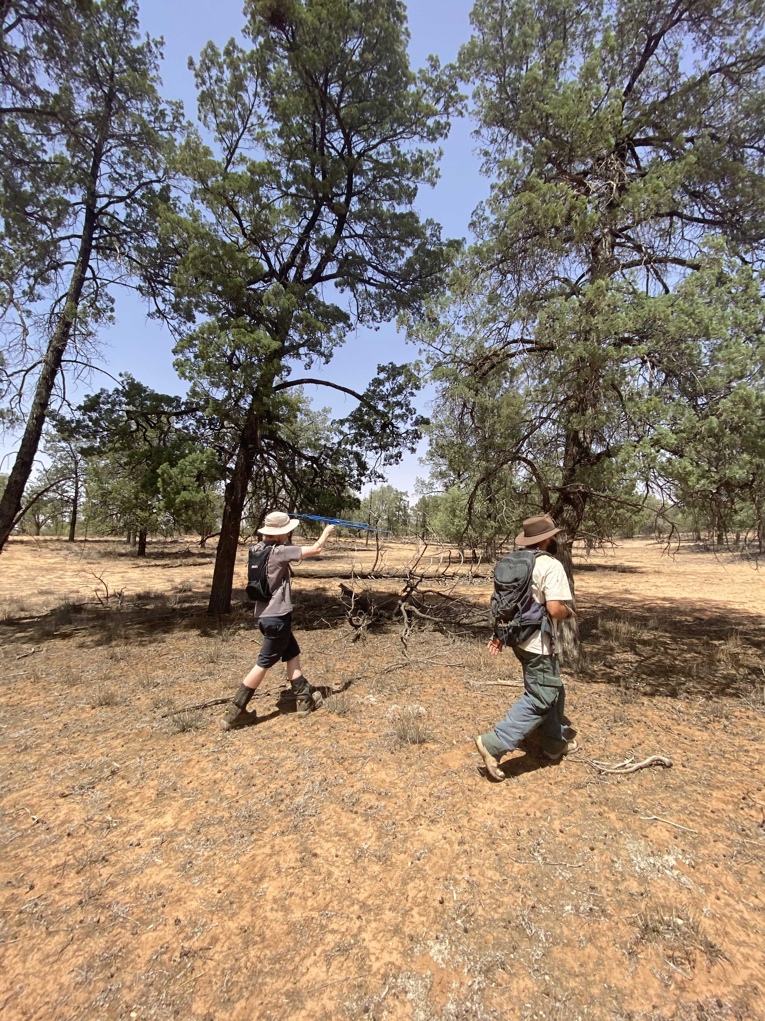
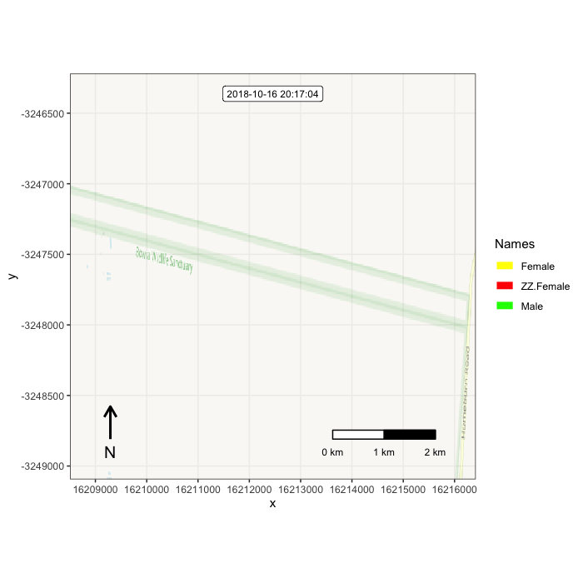

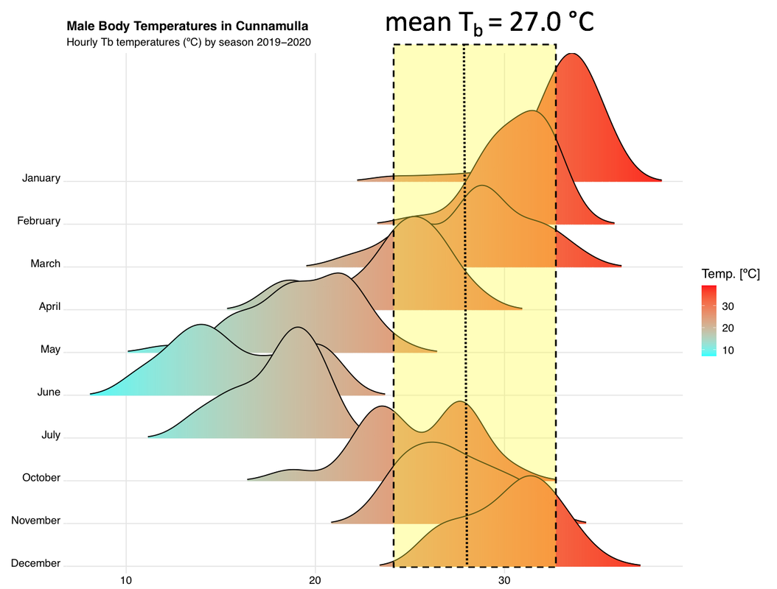
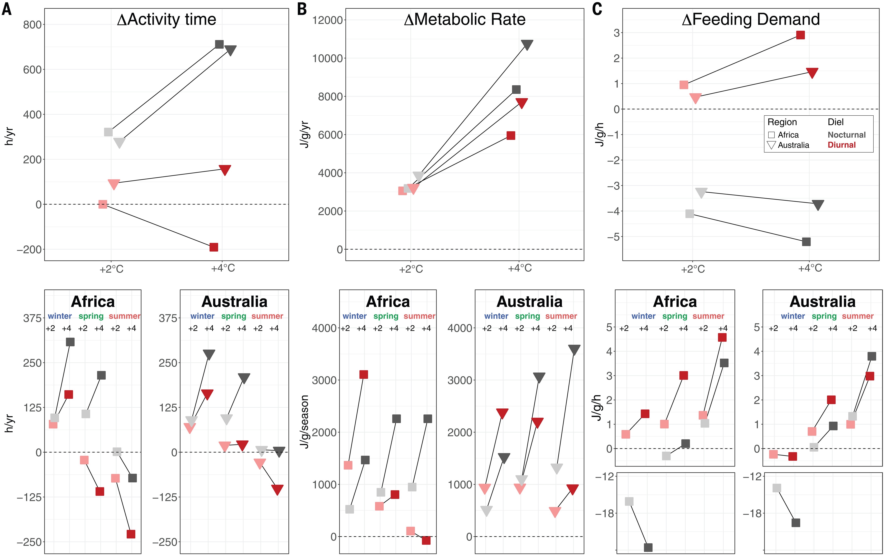
Kristoffer Wild
kristofferw@unimelb.edu.au
kwildresearch.com
Notes:
If there is time see what their names are and 1 thing they want to get out of the course\

Slide 4
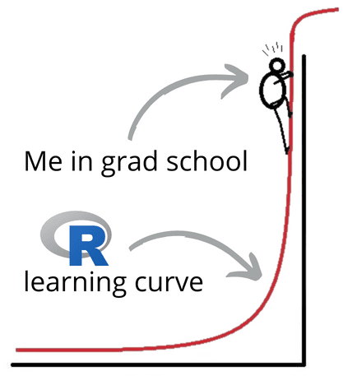
Notes:
If you’re like most students, you feel so much pressure trying to instantly understand R, while staring up at the steep and dreaded learning curve to do so.
I totally get it. And I can help.
After struggling with it myself, I actually came to love R.
Yep, I did.
See, R translates numbers into meaning, and allows you to handle your own data.

Slide 5
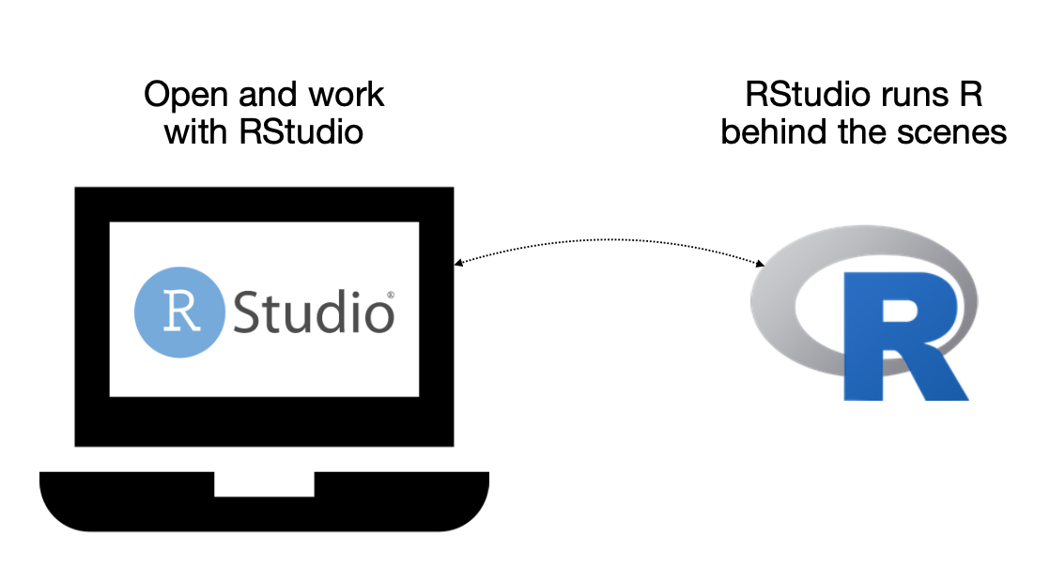

Learning objectives
Get familiar with R….
how to download R and R studio
setting up R studio
basic R functions
data types in R
installing a package
Working with dplyr
understanding a data frame
working with the common ‘verbs’
Notes:
Todays learning objectives are really getting you familiar with R.
I will do this by...

Slide 6
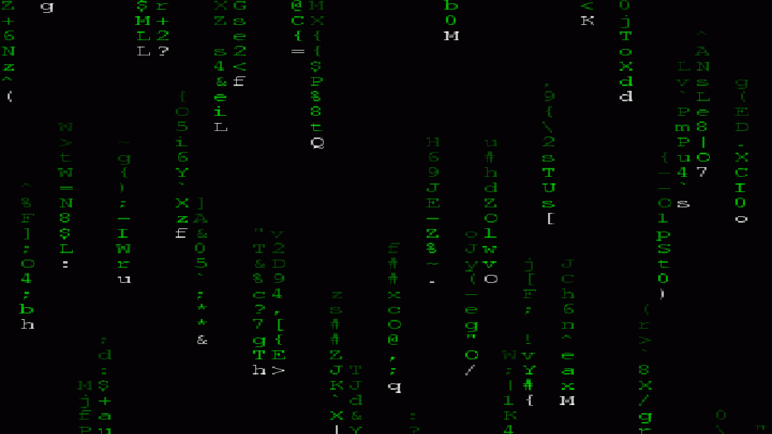
Today’s presentation
Introduction to R Programming Language
Structure of R
Installation and set-up
Data-types in R
Working with dplyr

Slide 7

1. Introduction to R Programming Language
R is a computing language that first appeared in the 1990s
Originally developed at the University of Auckland, New Zealand
Intended use was for performing statistics and generating graphics
Use now extends to many other areas:
DNA arrays
Gene expression arrays
RNA-seq analysis
Spatial ecology
Predecessor to R was S Programming Language, developed at Bell Laboratories in 1970s
R has come to be one of the primary computing languages used in bioinformatics
Notes:
R is a programming language that originated in the 1990s at the University of Auckland in New Zealand.
It was initially built for statistical computing and data visualization
— and it’s still one of the best tools for that.
But over time, its use has expanded into many areas, especially in biology.
Today, R is commonly used for analyzing DNA arrays, gene expression data, spatial analysis, LLMs
— making it a key language in bioinformatics and other aspects of ecology
Its roots go back to the S programming language, developed at Bell Labs in the 1970s,
and R has since grown into a global standard for scientific computing

Slide 8
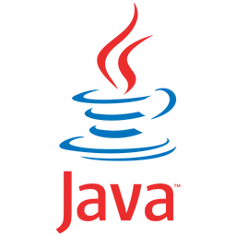
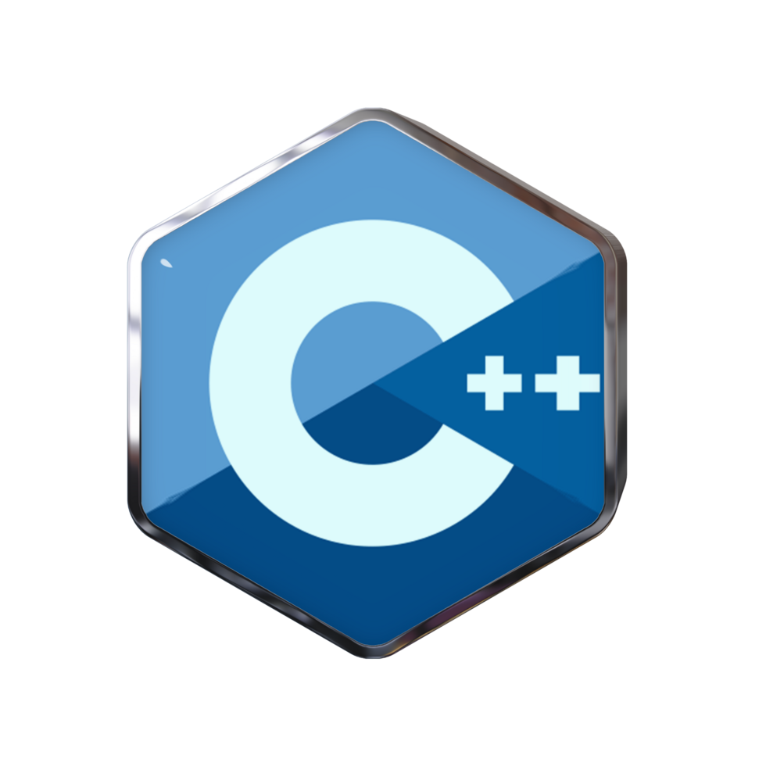
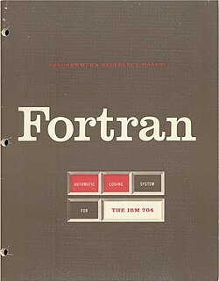
1. Introduction to R Programming Language
R is fundamentally a 'scripting' language, not a high-end programming language
Therefore it is limited in what it can do
High-end programming languages include C, C++, JAVA, Fortran
- these can be used to build complex, mainstream computer applications
R is mainly for short programs that are interpreted in a batch-like (sequential) manner
R was created using C and Fortran code
Notes:
Obligatory nerd slide about R....
R is a scripting language designed for simpler, sequential tasks.
This brings some limitations Because it’s a scripting language,
R is more limited in its capabilities compared to compiled languages.
High-end languages such as C, C++, Java, and Fortran are used to build complex, mainstream applications.
R is best suited for short programs that run sequentially in a batch-like fashion.

Slide 9

Today’s presentation
Introduction to R Programming Language
Structure of R
Installation and set-up
Data-types in R
Working with dplyr

Slide 10

2. Structure of R
The R environment is comprised of 'packages' (1,000s)
Packages are stored on the World Wide Web in repositories like CRAN (Comprehensive R Archive Network) and Bioconductor
A package can be thought as a set of functions that perform related tasks
dplyr popular data manipulation library
stringr for string manipulation.
ggplot2 package provides many graphical functions
When you first install R, many 'core' packages come bundled with the installation; other packages must be manually added
Notes:
But lets talk about R's strengths....
One of the key strengths of R is its package system.
There are thousands of R packages out there —
this is basically collections of functions grouped around specific tasks.
These packages are stored in online repositories like CRAN and Bioconductor.
For example, dplyr is great for data wrangling,
stringr helps with string manipulation,
and ggplot2 is widely used for creating graphics.
When you first install R, you get a set of core packages,
but most others need to be installed manually as needed.
We will go over this in a bit

Slide 11
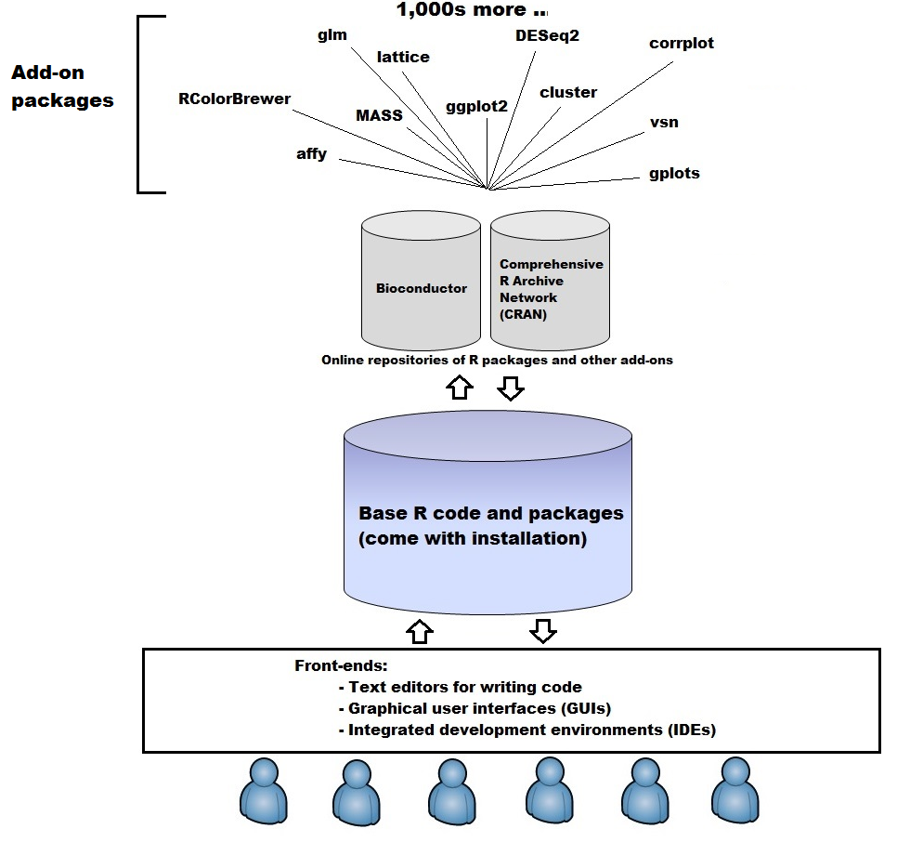
Notes:
This diagram shows how R is structured and how users like yourself will interact with it.
At the core, you have base R — this includes basic functions and packages that come with the initial installation.
On top of that, there are thousands of add-on packages, which you can download from online repositories like CRAN or Bioconductor.
These packages give R its power and flexibility — for example, ggplot2 for graphics, glm for modelling, and many more.
Finally, we interact with R through front-end tools — like RStudio, which is an integrated development environment, or simple text editors and GUIs.
- We will be using this
So, from base R to specialized packages, everything flows into the user experience.

Slide 12
Today’s presentation
Introduction to R Programming Language
Structure of R
Installation and set-up
Data-types in R
Working with dplyr
Notes:
Well next we need to get this fantastic program on your machines...
I'll convince you the others by hopefull 10am..
Show of hands who HAS R and R studio up and running?

Slide 13
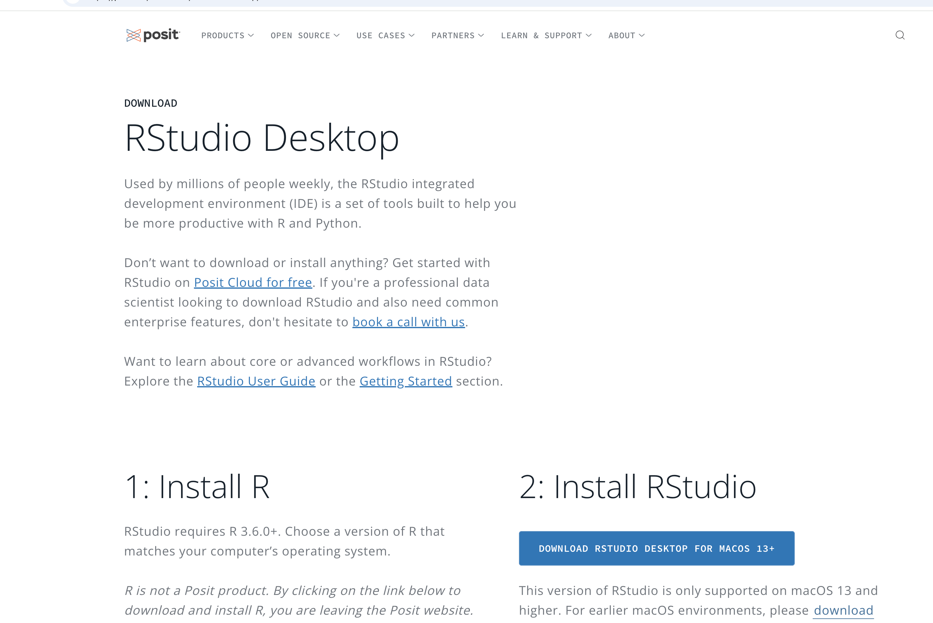
3. Installation and set-up (3 mins)
If you have not already, install R and RStudio on your computer
https://posit.co/download/rstudio-desktop/
Choose any mirror, closer ones will be faster

Slide 14


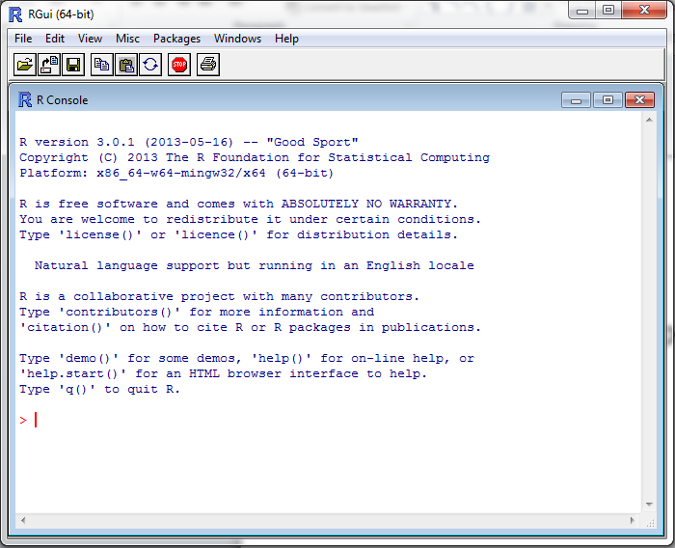
Load up R
Find the standalone R program
Open it
Enter commands at the > sign, e.g.
> 2 + 4
> x <- 7
> x + 19
The > is the R
command prompt
This font means this is an R command
Notes:
First, let’s just open base R…
Now, like 80s rap — it might look old-school, but it still hits hard and does the job. And works well. So I think of base R like Run-DMC: not flashy, but foundational — without it, nothing else works.
Even when you're working in RStudio, you're actually using base R under the hood.
To begin, open the standalone R program (the one with the blue R icon).
Type commands at the > prompt — that's R's way of saying “I'm ready for your code.”
Examples: The > symbol is the R command prompt, and this specific font means it’s an R command.

Slide 15
What is R doing?
The [1] means the first element of a vector
Even a single number in R is a vector, so “6” is a vector of size 1
> 2+4
[1] 6
> x <- 7
> x + 19
[1] 26
> X + 10
Error: object 'X' not found
<- means “assign” in this case “assign the value 7 to the variable x”
Some use = for this purpose but it is frowned upon
Adding 19 to x gives the expected value of 26
X is not the same as x
R is case sensitive: upper case letters are different to lower case letters
Notes:
So, what is R actually doing here?
First, we have a simple calculation :
2 plus 4 — and R returns 6.
Notice the one in brackets, which just tells us this is the first element of a vector.
Even single numbers in R are treated as vectors of length 1.
Next, we assign the value 7 to a variable called x using the arrow symbol.
It’s technically okay to use =, but it’s generally discouraged.
Then we add 19 to x and get 26, as expected.
Finally, the last line throws an error because we tried to use X with a capital letter.
This is just to highlight that R is case-sensitive, so X and x are treated as completely different variables.

Slide 16
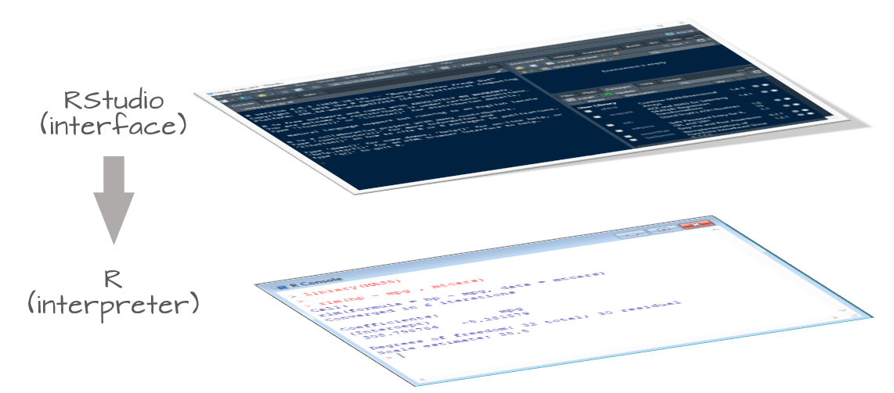
Rstudio: An Integrated Development Environment
It is tedious to write R code in the command line
Old style: create a text file (e.g. Notepad) and copy the code you want to run to the command line
Much better to use RStudio. Why?
Multiple input-output files
View variable values, color coding
Built-in help
Quick running of code
Easy file handling
Easy package installation
Many other reasons
Notes:
Writing R code directly in the command line can be clunky and inefficient.
The old-school approach involved using a text editor like Notepad and manually copying code over
— not ideal.
That’s why we use RStudio
Which is an integrated development environment that makes coding smoother and more intuitive.
You can view your files, data, plots, and variables all in one place.
It also has color-coded syntax, built-in help, easy file and package management,
and lets you run code quickly with just a keystroke.
Basically, RStudio turns R into a much more user-friendly workspace.

Slide 17
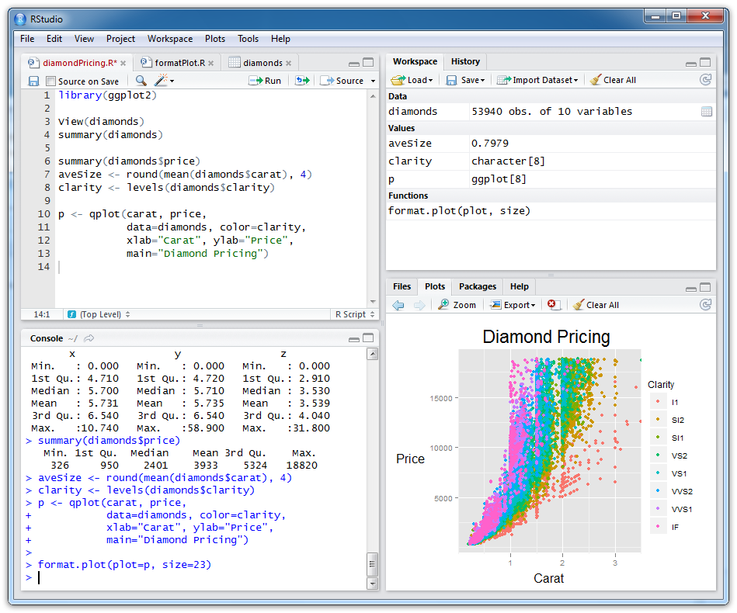
Rstudio: An example
Scripts (files
with R code)
Objects you have created
R console (results from
running R code)
Plots and help
Notes:
So here is the basic set up when you start up R studio for the first time
walk through

Slide 18
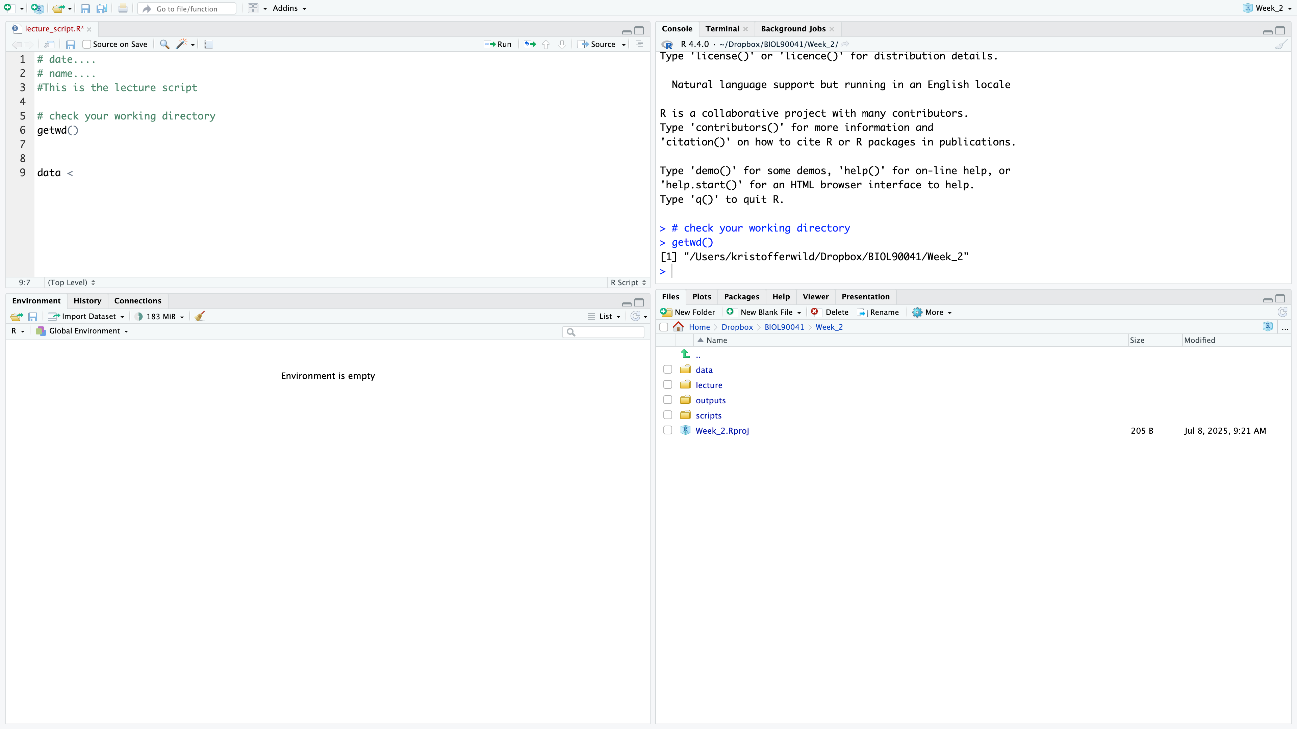
Rstudio: customise
Scripts (files
with R code)
Objects you have created
R console (results from
running R code)
Plots and help
Notes:
This is my set up...
Notice how some things have switched here from the last slide.
Can any one pick up on it?? CLICK
So like the environment on the left and
This is the beauty of R studio is the customisations you can do… Let me show you.

Slide 19
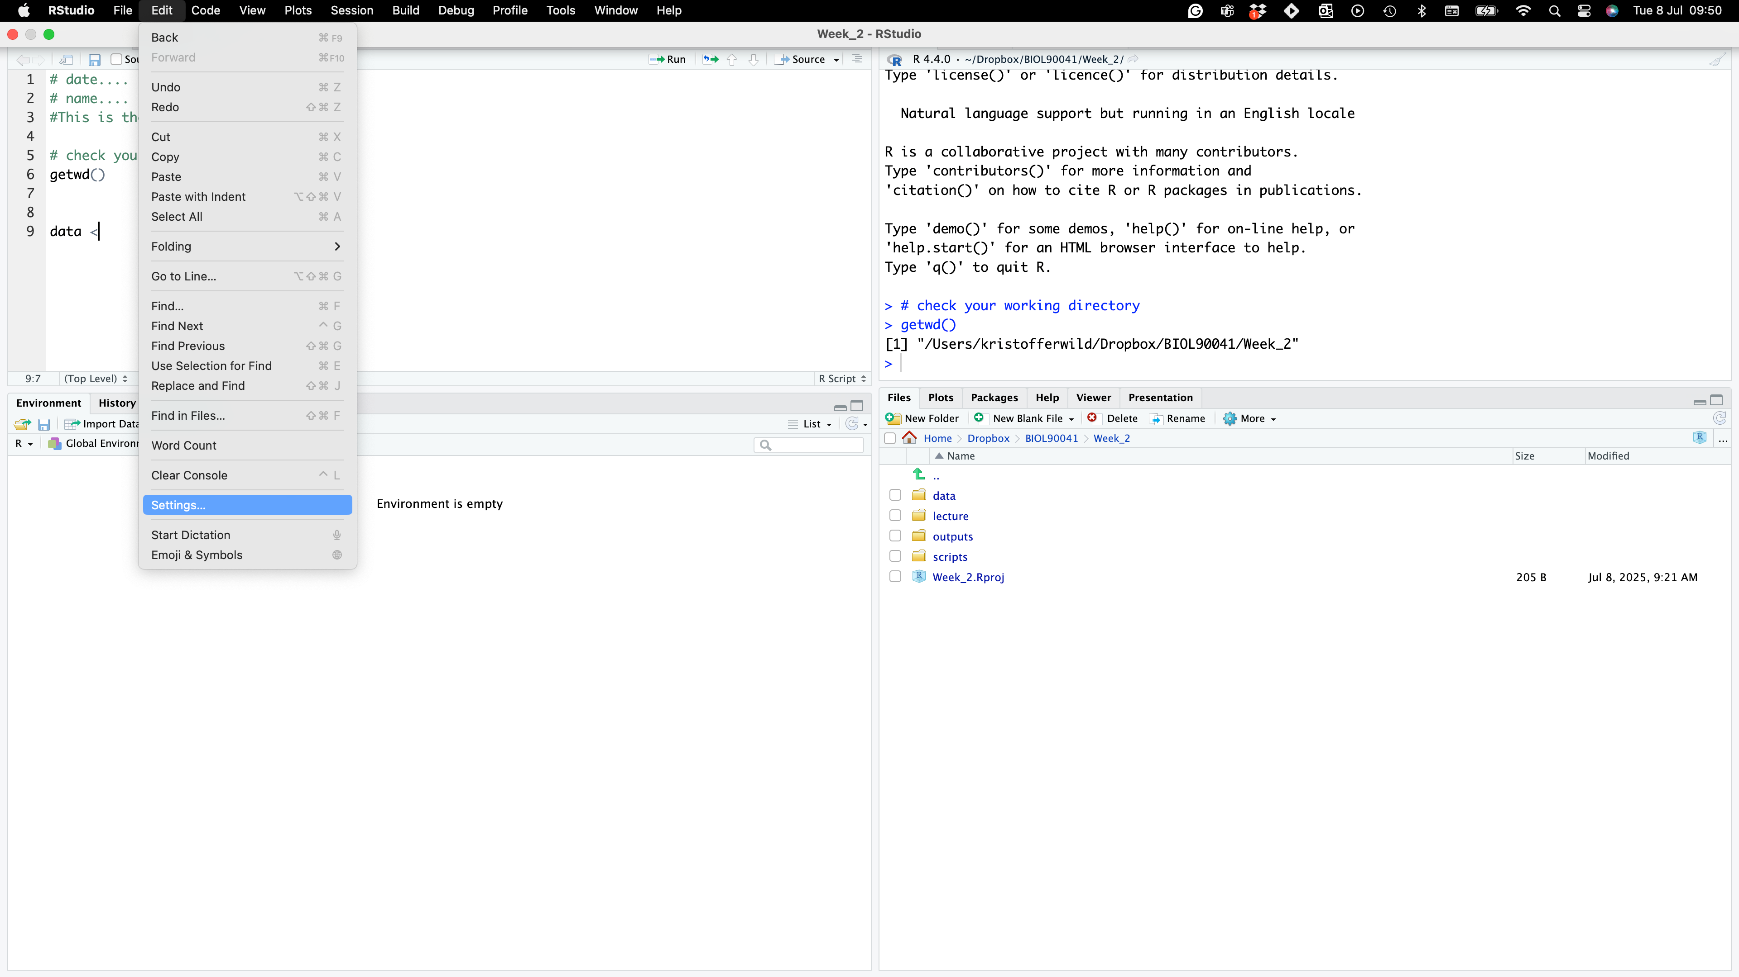
Rstudio: customise
Notes:
SO to change the panels or anything else like font size or color you go in the settings
REMEMBER TO TELL THEM TO CHANGE CODE WRAPPING

Slide 20
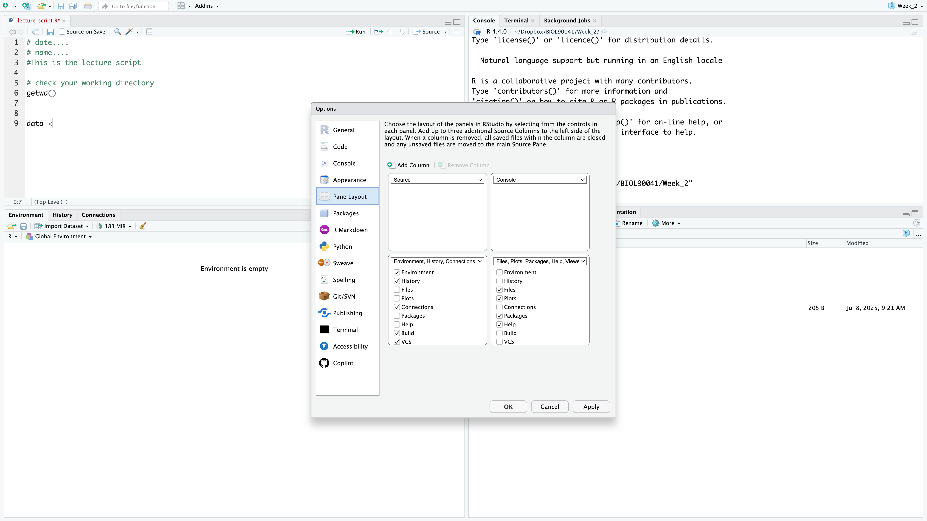
Rstudio: customise
Scripts (files
with R code)
R console (results from
running R code)
Objects you have created
Plots and help
Notes:
Pane layout to be like me. Change it here.
Also mention the code wrapping under CODE

Slide 21
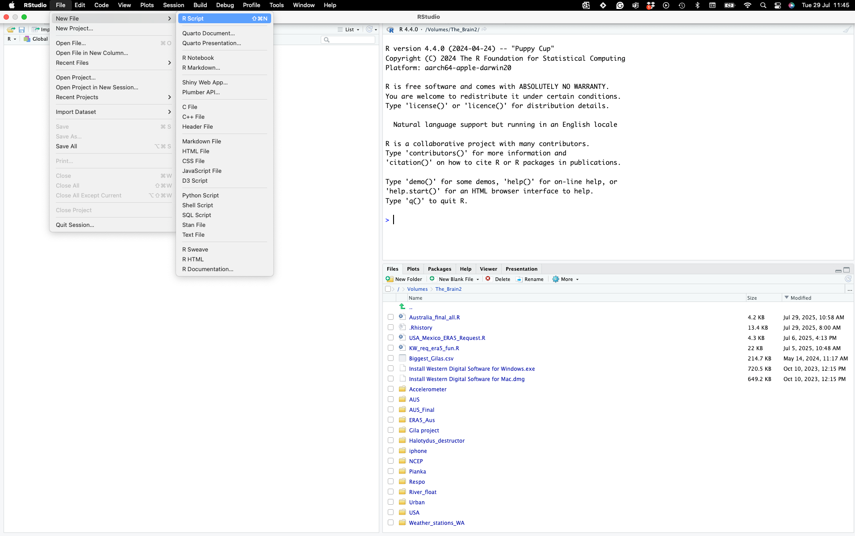
1. Introduction to R Programming Language
Create a script called ‘Lecture2_script.r’
In this lecture, code that you are expected to type is red and ‘have #s above it!’
Notes:
Now I want you to create a script...
We can just save it on your desktop for now...
dont fret I will not be giving you any data! Yet...
Today during the lecture if you see anything Red with hashes above it…
these are important functions you Will need to know.
I strongly suggest you write as many as these down to practice the code…
Also many of these examples will be on your quiz
and also Will be VERY useful for coding assignments

Slide 22
R scripts
A text file (e.g. Lecture2_script.r) that contains all your R code
It’s a complete record of your analyses
Reproducible: re-running your code is easy for you or someone else
Easily modified and re-run
In Rstudio to run code select code and type…
‘ctrl+enter’ for pc’s (YUCK!)
‘command+enter’ for Macs :D
SAVE YOUR SCRIPTS (unsaved scripts have red title)
Notes:
In RStudio, you'll usually write your code in a script file
— like this one, called Lecture2_script.r.
Think of it as a complete, editable record of your work.
It's great for reproducibility
— you or anyone else can re-run your analysis line by line.
It's also easy to tweak and rerun parts as needed.
To run your code, just highlight it and press
Command + Enter on a Mac,
or Control + Enter if you're on a PC — PC's are yuck...
And don’t forget to save your script
— RStudio will show a red title if the file hasn’t been saved yet.

Slide 23
Running a simple function
Function Name
Function Argument(s)
sqrt(10)
[1] 3.162278
Notes:
function is a self-contained block of code designed to perform a specific task
functions typically take input data (called arguments or parameters), process it,
and often return a result. .
They are fundamental for organizing code, promoting reusability, and improving readability.
So here is one calculating the square root of 10 ,
Within the function you have arguments
Then it will calculate the outcome (CLICK)

Slide 24

Running a simple function
# function self contained block of code,
# within brackets are arguments or parameters
DID YOU COMMENT AND CODE ???
sqrt(10)
[1] 3.162278
Notes:
Quick check… Did you commit your code and this example?
CLICK
I don’t expect you to do all of this but the more you do the more coding will become second nature.
It will also help you for your coding assignment that I’ll tell you about next week. The more you do now… The less you’ll do later

Slide 25
Help from within R
#Getting help for a function
> ?log()
> help("log")
Searching across packages
> help.search("logarithm")
Finding all functions of a particular type
> apropos("log")
[7] "SSlogis" "as.data.frame.logical" "as.logical" "as.logical.factor" "dlogis" "is.logical"
[13] "log" "log10" "log1p" "log2" "logLik" "logb"
[19] "logical" "loglin" "plogis" "print.logLik" "qlogis" "rlogis"
Notes:
"If you're ever stuck or unsure about a function in R, there's built-in help to guide you.
The easiest way is to type a question mark followed by the function name — like ?log() —
or you can use help("log").
If you're not sure what the exact function name is, help.search() will look through all installed packages for keywords like 'logarithm’.
And if you want to find any function related to a certain term, try apropos()
for example, apropos("log") brings up everything from log10 to plogis that has 'log' in its name."

Slide 26
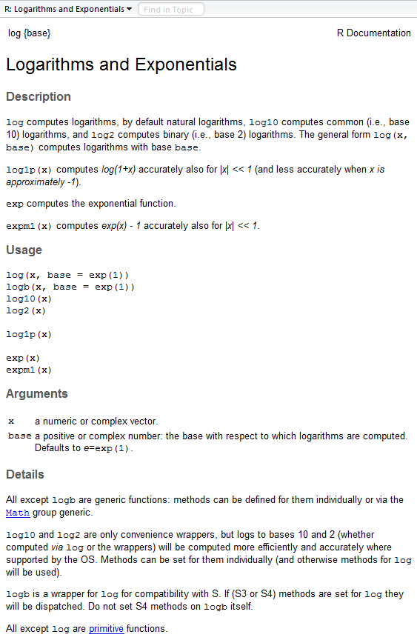
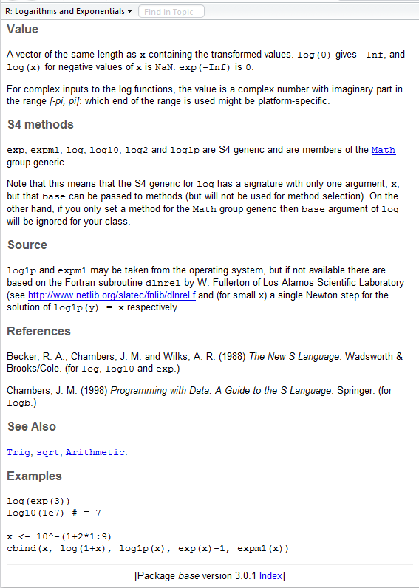
?log
What does the function return
What the function does in general terms
How to use the function
What does the function need
Discover other related functions
Sample code showing how it works
Notes:
When you open the help page for a function like log(),
you'll see a consistent structure that makes it easy to learn
At the top, there's a description of what the function does.
Next is usage, which shows the syntax.
Then, arguments — what inputs the function needs.
On the right, you'll see the value section, which tells you what kind of output the function returns.
Below that are examples, which are super helpful to see how it works in practice.
And finally, the see also section links you to related functions you might want to explore next.

Slide 27
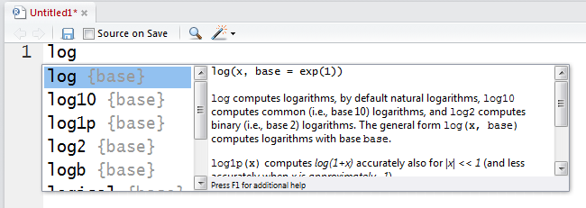
RStudio quick help
Start typing in the Scripts window (top-left)
Press <tab> and a list of available functions starting with those letters appears, plus help
Try typing log( and then pressing <tab>
Notes:
One really helpful feature in RStudio is the auto-complete.
As you start typing in the script window — for example, typing log( — you can press <tab>
and it’ll show you a list of functions that match, along with a short help description. I
It’s a great way to explore what's available or double-check what arguments a function needs without having to leave your script.

Slide 28
STOP AND CODE
Say you have this object below
cool_vec <- ‘kris is cool’
Now not knowing the rep() function, figure out how repeat that object 3 times using that function
Notes:
"Let’s say you’ve created a variable called cool_vec and assigned it the value 'kris is cool’.
Now you want to repeat that phrase three times, but you’re not sure how.
That’s when the help() function comes in. Try typing ?rep or help('rep') —
this will open the help file for the rep() function, which is short for 'repeat'.
You’ll see example usage and arguments.
So rather than guessing, use help like a pro! Give it a go

Slide 29
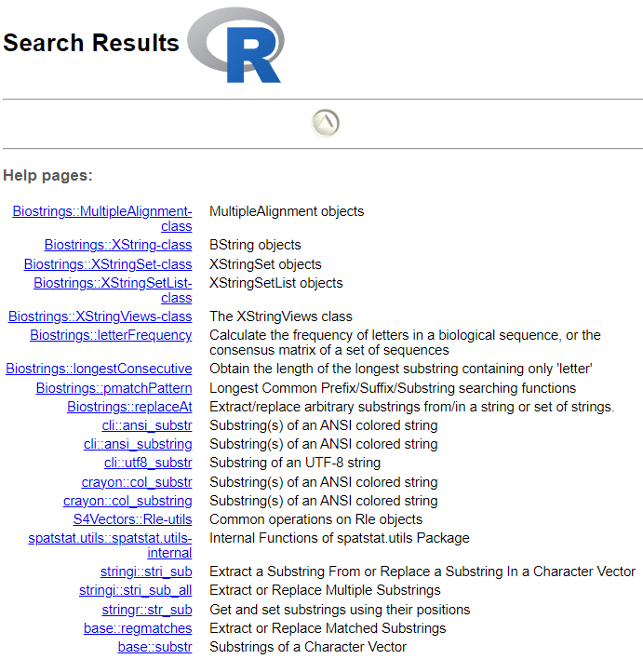
Searching Help
??substring
Package
Function
base::substr
Notes:
If you’re not sure where a function comes from, or want to search help across all installed packages,
you can use double question marks — like ??substring.
This searches not just the base R functions, but also help files from any loaded packages.
In the results, you’ll see functions like substr, along with the package they belong to
for example, base::substr means the substr function from the base package.
This is a helpful way to avoid confusion if multiple packages have similar functions.

Slide 30
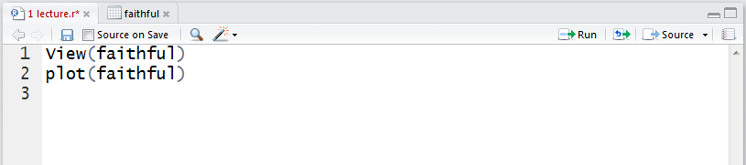
RStudio tips
Sends current line or selection to console (faster to type ctrl+enter)
Sends entire file to R console
Re-send the lines of code you last ran
(useful after edits)
Notes:
Here are a few quick RStudio tips.
The 'Run' button sends either the current line or your selected code to the console
but it’s faster to just use Ctrl + Enter or Command + Enter.
The blue arrow lets you re-run the last bit of code you executed
which is handy if you've made a quick change
And the 'Source' button runs the entire script from top to bottom
— good for checking your whole workflow in one go

Slide 31
Commenting your code (do it)
Use “comments” to document the intention of your code
Anything on a line after # is ignored by R
# Old Faithful Geyser, Yellowstone NP
plot(faithful)
Rules of thumb
Document the purpose of the code not how it works
Use good variable names
Assume you will remember nothing about the code when you look at it later (next week, year, decade)
RStudio: different color for comments
Notes:
Comments are a key part of writing good R code.
Anything after a hash is ignored by R, but it’s incredibly useful for you
and anyone else reading your code. Instead of explaining every line technically,
use comments to describe what the code is doing and why.
For example, here we’re noting that this data is from the Old Faithful Geyser.
Use clear variable names and write comments as if future-you will remember nothing
because honestly, you probably won’t

Slide 32
Some simple R commands
> 2+2
[1] 4
> 3^2
[1] 9
> sqrt(25)
[1] 5
> 2*(1+1)
[1] 4
> 2*1+1
[1] 3
> exp(1)
[1] 2.718282
> log(2.718282)
[1] 1
> log(10, base=10)
[1] 1
> log(10
+ , base = 10
[1] 1
Result of the command
Optional argument
Incomplete command
Order of precedence
Notes:
Here are a few simple R commands just to get familiar with how things work.
On the left, we’ve got basic math: addition, exponents, square roots, and how parentheses affect order of operations
just like in regular math.
On the right, we’re looking at functions like exp() and log().
You can include optional arguments, like setting the base of a logarithm using base = 10.
If you forget to close a parenthesis or complete your command, R will wait for the rest — which is what’s happening in the last example.
This is a good reminder to check your syntax if something seems stuck or unfinished.

Slide 33
Frequently used operators
<- | Assign
+ | Sum
- | Difference
* | Multiplication
/ | Division
^ | Exponent
%% | Mod
%*% | Dot product
%/% | Integer division
%in% | Subset
| | Or
& | And
< | Less
> | Greater
<= | Less or =
>= | Greater or =
! | Not
!= | Not equal
== | Is equal
Notes:
These are soome good operators that we will be using for clenaing our data.
I keep this pasted on my desk for reference!
For example lots of them are used in arguments for filtering

Slide 34
R workspaces
When you close your R session, you can save data and analyses in an R workspace
This saves everything run in your R console
Generally not recommended
Exception: working with an enormous dataset
Better to start with a clean, empty workspace so that past analyses don’t interfere with current analyses
rm(list = ls()) clears out your workspace
Summary: save your R script, don’t save your workspace
Notes:
When you close R, it asks if you want to save your workspace
— basically everything in your console.
While that might sound helpful, it’s usually not a good idea.
You risk carrying over old variables or mistakes into new sessions,
which can cause confusion.
A cleaner approach is to save your R script — that way, your work is documented and reproducible —
but skip saving the workspace.
If you want to start fresh,
the command rm(list = ls()) clears everything from memory.
The general rule: save your code, not your clutter

Slide 35
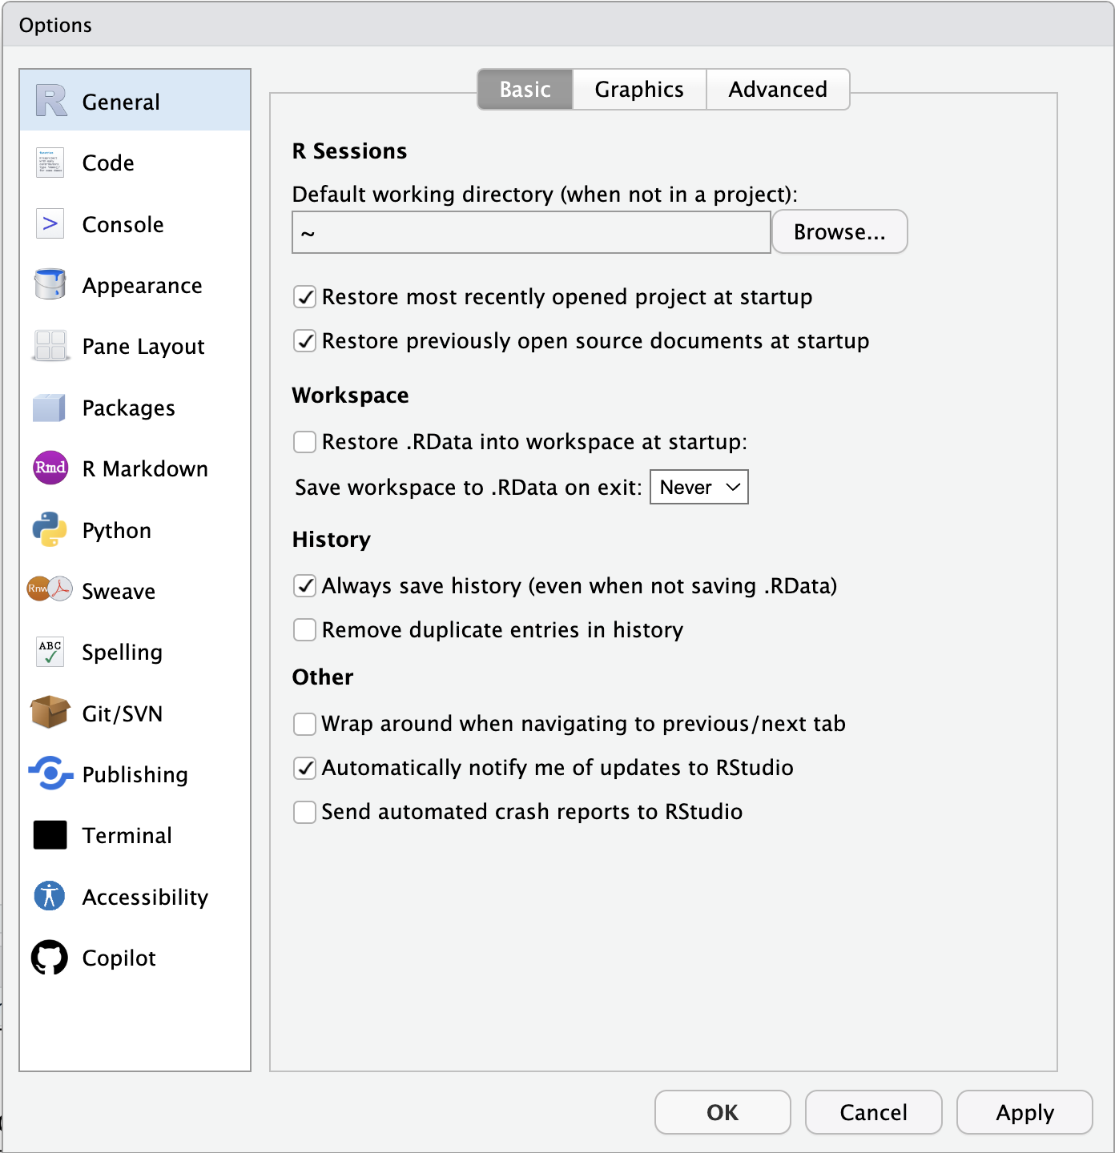
R workspaces
Turn off default saving/restoration of workspace
Edit → Settings…
Turn off “Restore .Rdata into workspace at startup”
Notes:
To avoid accidentally loading old variables every time you start RStudio,
it’s a good idea to turn off the default workspace saving.
Just go to Edit → Settings, and uncheck the box that says 'Restore .RData into workspace at startup’.
This makes sure you always start with a clean slate,
which helps prevent confusion and keeps your work reproducible.

Slide 36
STOP AND CODE
Use R to do the following. Using your ‘Lecture2_script.r’ answer the following. Remember to save & comment ‘#’ your work:
1) 1 + 2(3 + 4)
2) ln(4³+3²⁺¹)
3)
4)
Try running these!
Notes:
# 1) 1 + 2(3 + 4)
1 + 2 * (3 + 4)
# Answer: 15
# 2) ln(4^3 + 3^2 + 1) — in R, use log() for natural log
log(4^3 + 3^2 + 1)
# Answer: log(64 + 9 + 1) = log(74) ≈ 4.304065
# 3) sqrt((4 + 3) * (2 + 1))
sqrt((4 + 3) * (2 + 1))
# Answer: sqrt(7 * 3) = sqrt(21) ≈ 4.582576
# 4) ((1 + 2)/(3 + 4))^2
((1 + 2)/(3 + 4))^2
# Answer: (3 / 7)^2 = 0.1836735

Slide 37
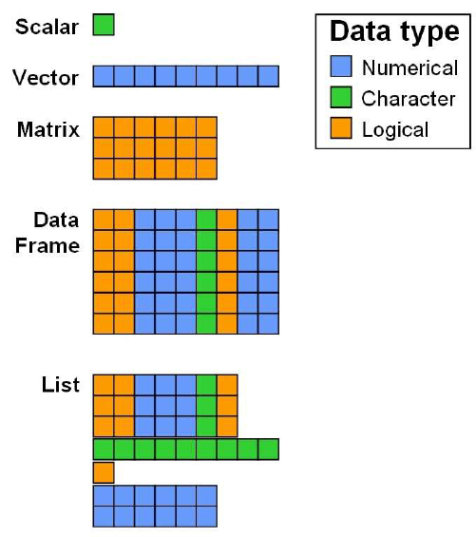
Objects
Every programming outcome in R can be stored as an object
Numbers
Characters (i.e. text or strings)
Tables
Vectors and matrices
Plots
Statistical output
Functions
Good names for objects are critical
Objects in R are global
Notes:
In R, just about everything you create
— whether it’s a number, some text, a table, a plot, or even a function
it can be stored as an object.
This makes it easy to reuse, modify, and build on your work.
Giving your objects clear and meaningful names is super important
so you don’t lose track of what’s what.
One thing to keep in mind is that objects are stored in the global environment,
meaning they’re accessible from anywhere in your script unless you specifically isolate them.

Slide 38
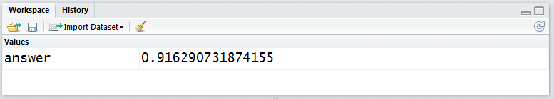
Assigning values
# Assign the result of log(2.5) to a new object called “answer”
answer <- log(2.5)
answer = log(2.5)
answer <- log(2.5, base=10)
# = can be used instead of <- but is frowned upon; # YUCK!!!
# optional argument
When you run this command, an object “answer” is created in the workspace that is assigned the value of 0.91629… In RStudio, the workspace window lists all the objects in the current workspace
Notes:
Here we’re assigning the result of log(2.5) to an object called answer.
This stores the result so we can use it later.
I will always use the arrow <- used for assignment
but like I said before R does allow = , it's generally discouraged for consistency and clarity.
You can also include optional arguments, like setting the log base to 10.
Once you run this line, RStudio shows your object in the Workspace pane, along with its value
in this case, about 0.91629.
This is a great way to keep track of what you’ve created.

Slide 39
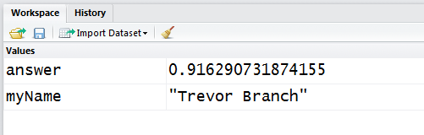
Assigning values
# Characters can also be assigned to objects
myName <- "Trevor"
myName <- 'Trevor'
> (myName <- "Trevor Branch")
[1] "Trevor Branch"
# Usually we use double quotation marks, but # single quotes are treated the same
# Surrounding a command in ( ) will display
# the assigned value in the R console; Can include spaces
Notes:
You can also assign text called character strings to objects.
For example, here we assign the name 'Trevor’
to the object myName using quotation marks.
You’ll usually use double quotes, but single quotes work the same in R
If you want to see the value printed right away when assigning it, just wrap the assignment in parentheses.
You can also include spaces in strings — like 'Trevor Branch' — and R will store it as-is.
Once assigned, you’ll see your object show up in the Workspace window with its value.

Slide 40
Viewing objects
RStudio: just look at the top-right Workspace tab
Alternatively (and more generally):
> print(answer)
[1] 0.9162907
> answer
[1] 0.9162907
> answer * 10
[1] 9.162907
# Very general command, works on everything
# Manipulate the value contained within the object
Notes:
If you want to check the value of an object in R, there are a few easy ways to do it.
You can look at the Workspace tab in RStudio, where all your objects and their values are listed.
Or, more generally, you can just type the object’s name
— like answer — or use print(answer) to show it in the console.
Once you have an object, you can use it in further calculations too
for example, answer * 10 gives you the result multiplied by 10.

Slide 41
Removing objects
# To find a list of all objects in the workspace
> ls()
[1] "answer" "myName"
# To remove an object
> rm(answer)
> ls()
[1] "myName"
To remove all objects
> rm(list = ls())
> ls()
character(0)
Nothing left in workspace
Notes:
To see what objects are currently in your R workspace,
use the ls() command
it lists everything you've created so far.
If you want to remove a specific object, like answer, you can use rm(answer).
To remove everything and start fresh
run rm(list = ls()).
That clears the entire workspace, and running ls() after that should return character(0)
meaning there’s nothing left

Slide 42
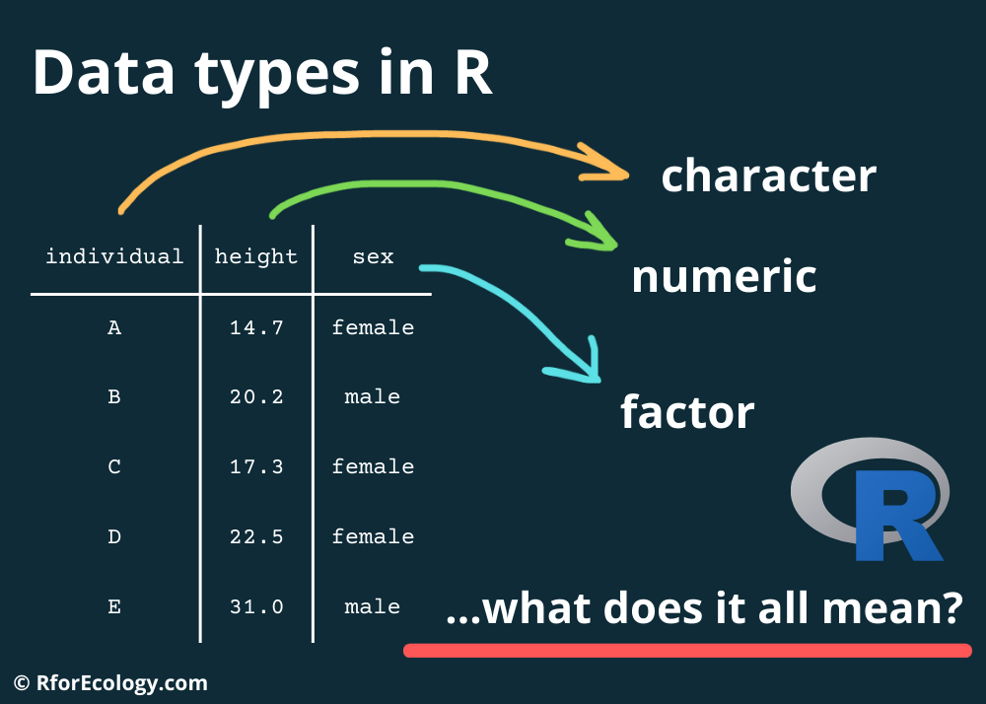
Today’s presentation
Introduction to R Programming Language
Structure of R
Installation and set-up
Data-types in R
Working with dplyr
Notes:
Now we are going to quickly go thorugh different data types in R:

Slide 43
Data types
Data types describe how objects are stored in computer memory
In R, you do not need to specify the data type
Common data types (also known as mode) include
Numeric (integer, floating point numbers or doubles)
Logical (Boolean, true or false)
Characters (text or string data)
The object type is not always obvious in R, and knowing what it is can be important
Notes:
Data types describe how R stores information in memory
and even though R doesn’t make you declare a type up front, it still matters.
Some of the most common types are:
numeric, which includes both whole numbers and decimals;
logical, which are just TRUE or FALSE;
and character, which refers to any kind of text.
The tricky part is that the type isn’t always obvious just by looking
so it’s important to know how to check and handle data types properly,
especially when you're debugging or combining different objects.

Slide 44
Finding data types??
> answer <- log(2.718282)
> answer
[1] 1
# Is it numeric or text?
> mode(answer)
[1] "numeric"
# Part of a family of is. functions
> is.numeric(answer)
[1] TRUE
Specifically, what type of object is it?
> typeof(answer)
[1] "double”
The as. functions coerce objects from one type to another
> answer <- as.integer(answer)
> typeof(answer)
[1] "integer"
Notes:
If you’re ever unsure about what kind of data you’re working with in R,
there are a few handy functions to check.
First, mode() tells us whether something is numeric, character, or logical.
is.numeric() goes a step further
— it's part of the family of is. functions that return TRUE or FALSE.
To dig deeper, typeof() reveals the internal storage type
for example, a numeric value like 1 is actually stored as a 'double’.
If needed, you can force an object into another type using as. functions
like converting a double into an integer with as.integer().
That changes how it’s stored and may affect how R handles it in calculations

Slide 45
Everything is a vector
Vectors are the most basic unit of storage in R
Vectors are ordered sets of values of the same type
Numeric
Character (text)
Logical (TRUE or FALSE)
Date etc…
10 -> x
x is a vector of length 1 with 10 as its first value
Notes:
In R, everything is built on vectors
— they’re the most fundamental unit of storage.
A vector is just an ordered set of values, but all those values have to be of the same type
like numeric, character, logical, or even dates.
Even a single number, like 10, is considered a vector of length 1.
You can assign it using <- or the reverse, like 10 -> x, and R will treat x as a numeric vector with just one element

Slide 46
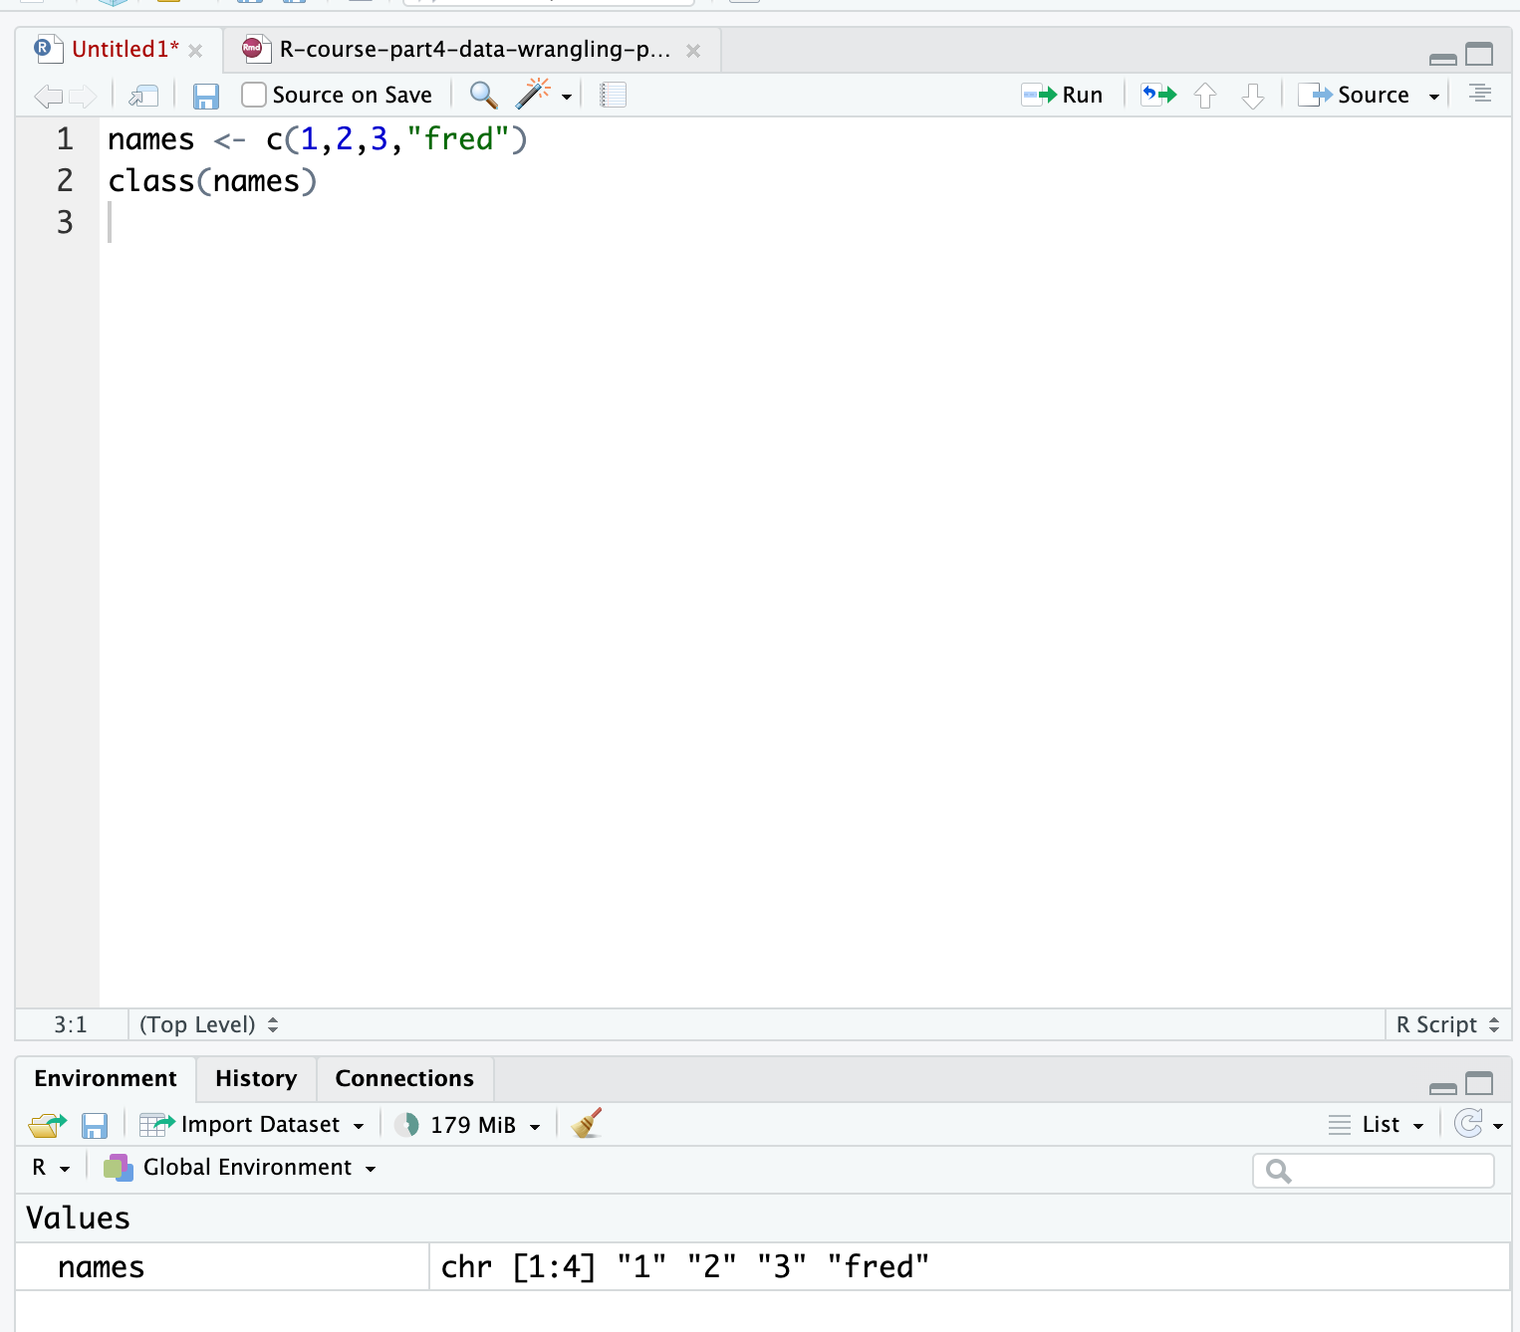
Creating vectors manually
#Use the c (combine) function
#Data must be of the same type
c(1,2,4,6,3) -> simple.vector
c("simon","laura","sarah","jo","louise") -> some.names
names <- c(1,2,3,"fred")
[1] "1" "2" "3" "fred"
Question: What was the class() of the object ‘names’?
Notes:
To create vectors manually in R, we use the c() function — short for 'combine’.
For example, c(1, 2, 4, 6, 3) creates a numeric vector, and you can assign it to a name like simple.vector.
You can also combine character data, like names.
But here's the key rule: all values in a vector must be the same type.
So if you mix numbers and characters, R will convert everything to the most flexible type
— in this case, characters.
That's why when we run c(1, 2, 3, 'fred'), the result is actually a character vector
So can I get you guys to to confirm that with class(names) (CLICK)
CLICK - check out your enviorment... Notice the chr

Slide 47
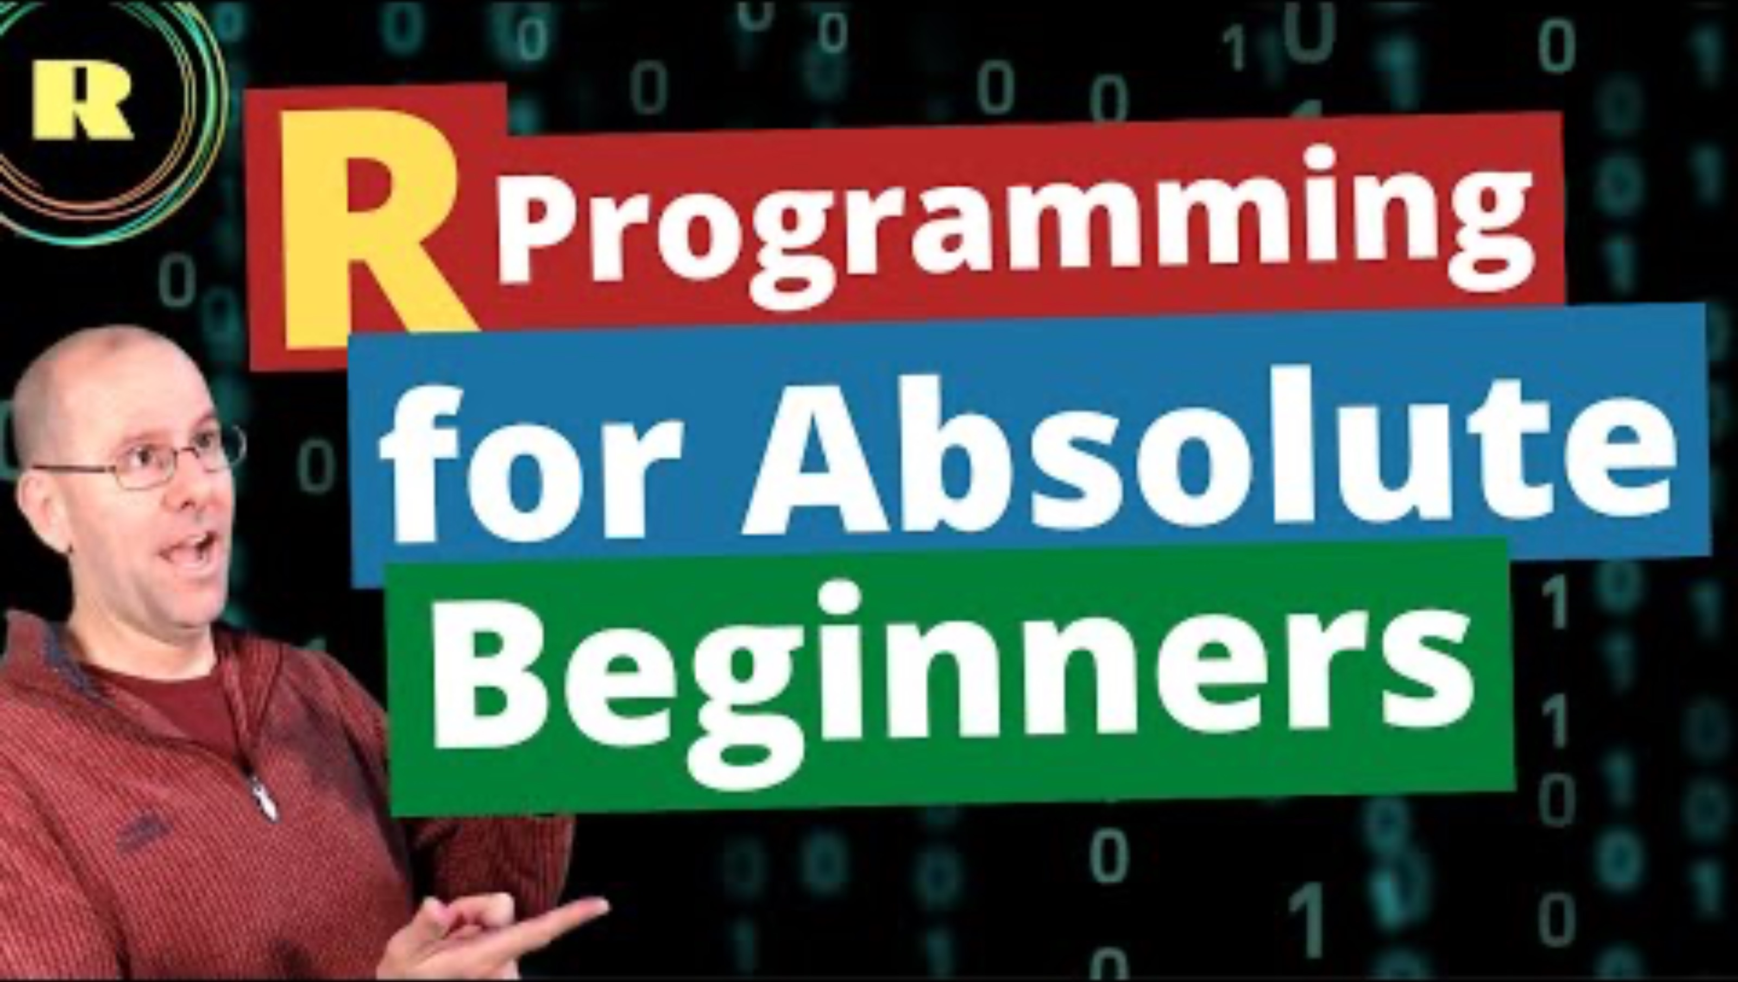
Catching up on the basics
If this was a lot just take a look at this video for some extra practice:
Notes:
Okay thats really the basics quickly...
If that was too much I want you guys to get some extra practice...
Have a look at this video for some other examples.

Slide 48
Data Frames and Lists
Multivariate data consists of multiple data vectors considered as a whole.
We’re free to work with our data as separate variables, but it can behoove us to combine related vectors into a single object such as a data frame, which is used to store a rectangular grid of data.
Usually, rows correspond to experimental units/subjects, and columns correspond to variables/measurements.
All column lengths are the same.
A list is a more general storage object which is comprised of a collection of components
Size of the objects can differ.
Anything goes in terms of structure!
Notes:
In R, when we’re working with multivariate data
— like multiple measurements from a study we often group them into a single structure.
A data frame is the most common way to do that.
It organizes data into rows and columns, where each row is an observation and each column is a variable.
Importantly, all columns must be the same length.
If we need more flexibility
— say, we want to store different types of objects or even vectors of different lengths
we can use a list instead.
Lists are more general-purpose and can hold just about anything:
numbers, strings, models, or even other lists.
But that flexibility also means they’re a bit more complex to work with.

Slide 49
Examples of Both
Data frame: Any one of the various data sets we will be using
List: Typically the output of a function. E.g., consider the object
Dhf = density(iris$Sepal.length)
We can check that Dhf is a list via summary(Dhf), which tells us each component and gives its data type.
Notes:
In practice, you’ll see data frames used all the time
— especially when working with datasets like the built-in iris dataset.
But when you run a function like density(), the result is usually a list.
For example, if we run density(iris$Sepal.Length) and store it as Dhf,
we’re creating a list that holds multiple components
— like values, bandwidth, and call information.
You can confirm that with summary(Dhf),
which gives you an overview of all the components and their types.
This highlights how lists are the go-to structure for storing more complex outputs.

Slide 50
Creating a Data Frame or List
#Data frames are created with data.frame(). E.g.,
x<-1:2
y<-letters[1:2]
z<-1:3
data.frame(x,y)
data.frame(x,y,z) #error due to unequal lengths
#Lists are created with list(). E.g.,
list(x,y,z) #unnamed components
list(x.name=x,y.name=y,z.name=z) #named components
Notes:
To create a data frame in R, we use the data.frame() function.
Here we define three vectors: x, y, and z. (CLICK)
Vectors x and y both have two elements, so combining them into a data frame works fine.
CLICK
But if we try to include z, which has three elements, we get an error - any one know why????
because all columns in a data frame must be the same length.
Lists, on the other hand, don’t have that restriction..
You can combine x, y, and z into a list with list(x, y, z).CLICK
You can even name the components using syntax like list(x.name = x, y.name = y, z.name = z).
This gives you a flexible structure where the elements don’t need to match in size or type

Slide 51
Accessing Values in a Data Frame
# Can access values with either the name of a column or with row column notation
DF <- data.frame(x,y)
DF$x #access x column of DF
DF$[,’x’] #access column named x
DF$x[1] #access first entry in column x of DF
DF[1,2] # access entry in first row, second column
Notes:
Once we’ve created a data frame, we can access its values in a few ways.
The most common is using the string or money sign operator followed by the column name —
like DF$x to access the column named 'x’.
Alternatively, we can use bracket notation: DF[, 'x'] also pulls out the 'x' column, and DF$x[1] gets the first value in that column.
If you want to access values by position, you can use bracket row, column bracket format
for example, DF[1, 2] gets the value in the first row and second column

Slide 52
Accessing values in a list
#If list components are unnamed, use double-bracket notation [[]].
lst = list(x,y,z)
lst[[1]] #access first component x
#If components are named, access using $comp.name.
lst.named = list(x.name=x, y.name=y, z.name=z)
lst.named$x.name
names(lst.named)
lst.named[['x.name']]
For both data frames and lists, can edit values or components by accessing them and reassigning them, or using edit(obj).
Notes:
Now let’s look at how to access values in a list.
If the list components are unnamed — like in lst = list(x, y, z)
— we use double square brackets to access elements by position.
So lst[[1]] returns the first component, which in this case is x.
But if your list has named components
like lst.named = list(x.name = x, y.name = y) —
then you can use the $ operator just like in a data frame: lst.named$x.name.
You can also inspect the names using names(lst.named), and access named components with double brackets too, like lst.named[['x.name']].
For both lists and data frames, you can always edit individual values by accessing them and reassigning
or use edit(obj) to open up a manual editor in R."

Slide 53

Today’s presentation
Introduction to R Programming Language
Structure of R
Installation and set-up
Data-types in R
Working with dplyr
Notes:
So all of that was a quick way of how we can use R using base comannds,
Now I’m going to introduce a package that we Will be using for much of the data wrangling and manipulation
in this class and probably with your masters

Slide 54
Data manipulation with dplyr
Notes:
The package is dplyr

Slide 55

But first…. We use pacman to load and upload packages
What is pacman???
Combines and simplifies base R package functions with p_xxx commands
Speeds up workflows and reduces code when added to .Rprofile
p_load() loads and installs missing packages in one step
Most functions don’t require quotes around package names
Ideal for scripts, teaching, and sharing reproducible code
Notes:
Before we dive in, we’re going to use a handy package called pacman.
It’s basically the Pac-Man of R packages
— chomping through your install and load steps all in one go.
So what is pacman? It’s a package that simplifies how we deal with other packages.
It gives us p_ commands like p_load(),
which will install a package if needed and then load it — all in a single line.
That means you don’t need to run install.packages() and library()
— just use p_load() and you’re done.
This is especially great for teaching and scripting,
since you don’t have to think about whether a package is already installed or not. It just works.

Slide 56
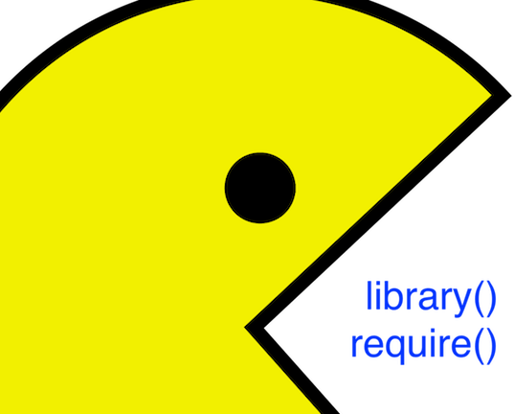
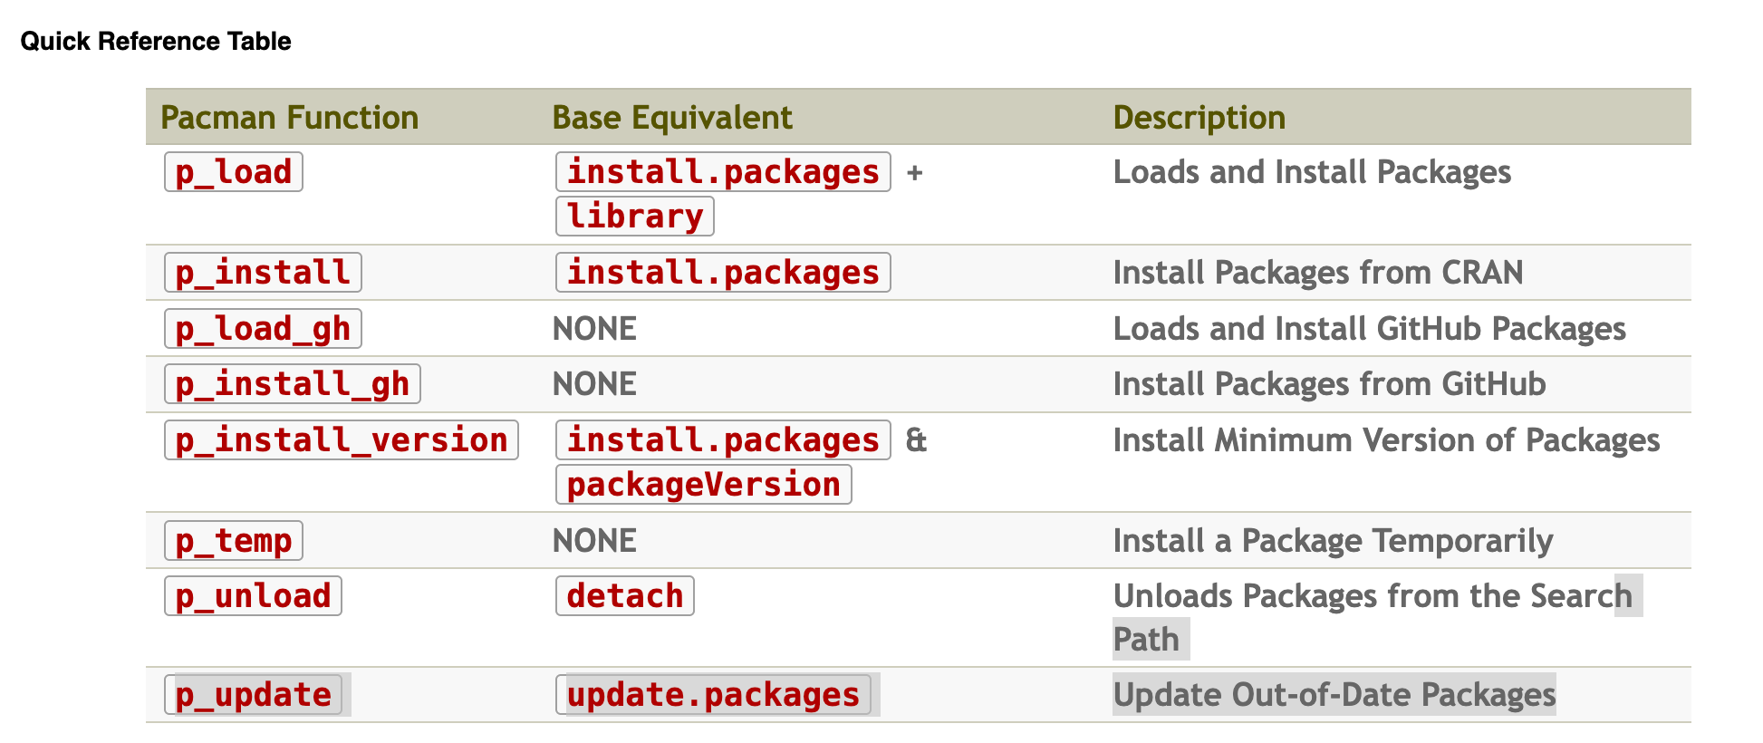

Install pacman
#Install pacman if not already installed
install.packages("pacman")
#Now use p_load() to load dplyr and nycflights13 (installs if missing)
pacman::p_load(dplyr, nycflights13)
# you will now use the function p_load() and any package at the start of all of your scripts!
Notes:
So here is what I want you all to do.
Install this package.
Now we will use the pload function to download dplyr and nycflights 13… I’ll explan.
I wish I knew about this when I was in your sures, I was yester-years old when I found out with it. CLICK
Now I’ll pass this on to you and you will use it at the start of all of your scripts . CLICK

Slide 57

dplyr and Tibbles
dplyr Contstrains options, helps one think about data manipulation challenges.
Provides simple “verbs”, functions that correspond to common data manipulation tasks
Works efficiently and quickly
Utilizes objects known as tibbles, which can be thought of as modernized data frames
E.g., flights (nycflights13) is saved as a tibble object
To convert a data frame to a tibble, use as_tibble()
Notes:
dplyr is a core tidyverse package that helps you manipulate data using simple,intuitive functions
like filter(), select(), and mutate().
It works best with tibbles, which are just modern data frames
— they print cleaner and don’t mess with your data types.
Most datasets we’ll use, like flights from nycflights13, are already tibbles.
But with your data you may have to convert them to tribbles
If you need to convert a regular data frame, just use as_tibble()

Slide 58
Single Table Verbs
dplyr aims to provide a function for each basic task of data manipulation.
As in base R, all the output of all of these functions can be stored as an object in the workspace.
filter() | Select cases based on their values
arrange() | Reorder based on values of a variable
select() and rename() | Select variables based on their names.
mutate() and transmute() | Add new variables that are functions of existing variables.
summarise() | Condense multiple values to a single value
sample_n() and sample_frac() | Take random samples.
Notes:
dplyr gives us a set of consistent, easy-to-remember functions — or verbs —
for common data manipulation tasks.
Each one does a specific job:
filter() lets you pick rows based on conditions,
arrange() reorders rows,
select() and rename() help you pick or rename columns,
mutate() and transmute() create new variables,
summarise() condenses values,
and sample_n() or sample_frac() give you random samples.
All of these return an object you can save, just like in base R."

Slide 59

Data: nycflights13
We’ll explore all this through the example of the flights from the nycflights13 package, which contains info on all 336,776 flights that departed from NYC in 2013.
- just type ‘flights’ in your script
Stop and check
Is flights a data frame or a list?
How many columns are there?
How many rows?
how many columns are numeric?
Notes:
So lets look at the flights data`

Slide 60
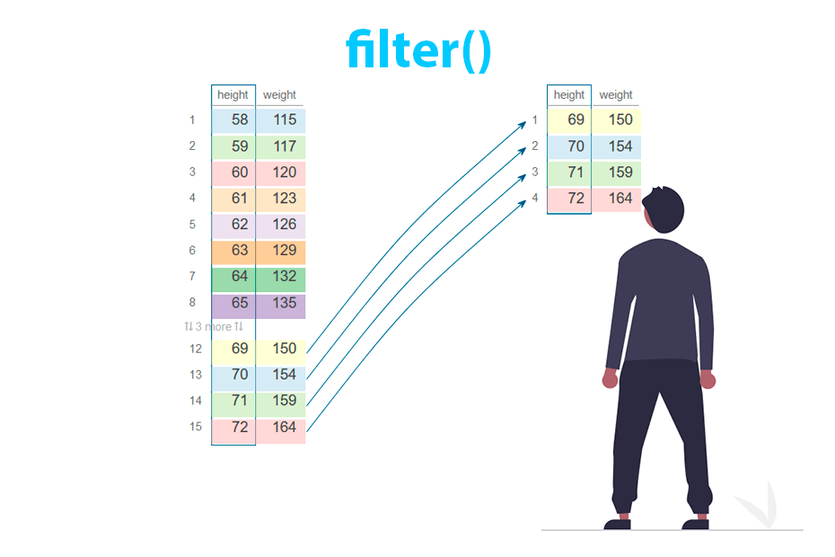
filter()
filter() allows us to select a subset of a tibble. The first argument is the tibble object, and the subsequent arguments are logical expressions for the data, separated by commas.
The function returns all data for which all logical statements are TRUE.
# E.g., select all flights on January 1st:
filter(flights, month==1,day==1)
Roughly equivalent to R-base code
flights[flights$month==1 & flights$day==1]… Yuck
When using dplyr functions, do not need to use attach() or $ notation.
Notes:
filter() is one of the core dplyr verbs, and it's used to return only the rows that meet certain conditions —
basically, it's how we subset data.
The first argument is always your tibble, and then you list the conditions you want
CLICK
— for example, filter(flights, month == 1, day == 1) gives us only the flights on January 1st.
This is way more readable than base R, where we’d have to write something like
flights[flights$month == 1 & flights$day == 1].
With dplyr, you skip all the $ signs and brackets — and that makes it much easier to read, teach, and build up workflows step-by-step.
It’s also great when you’re combining multiple filters or chaining with pipes

Slide 61
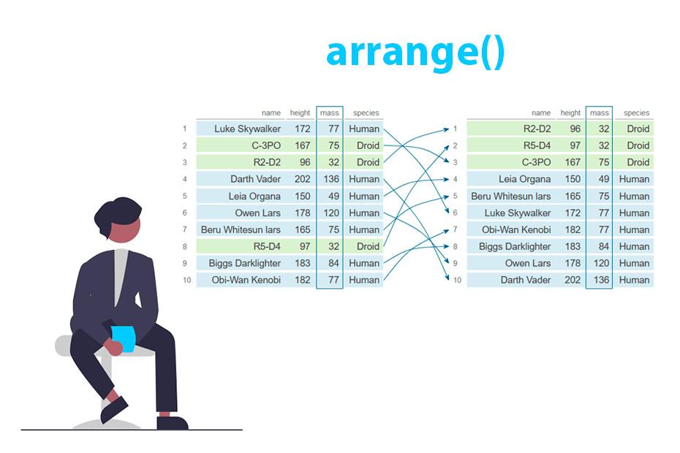
arrange()
arrange() works similarly to filter(), except that it reorders rows according to the ordering of one or more particular variables instead of subsetting them.
First argument is the tibble, the second argument is the reordering variable, and subsequent arguments are variables that break ties of the variable immediately preceding them.
# E.g., sort by scheduled departure time (sched_dep_time), using departure delay (dep_delay) # to break ties:
arrange(flights, sched_dep_time, dep_delay)
# Use desc() on one of the reordering variables to sort by descending # order of that variable:
arrange(flights, desc(sched_dep_time), dep_delay)
Can reorder by as many variables as you like!
Notes:
arrange() is used to reorder rows in your dataset based on the values of one or more columns.
So instead of filtering out rows, like filter(), this just changes their order.
The first argument is always your tibble, and then you list the variables you want to sort by
CLICK
for example, arrange(flights, sched_dep_time, dep_delay) will sort by scheduled departure time, and then break ties using departure delay.
If you want to sort in descending order, just wrap the variable in desc().
And you’re not limited to two
— you can sort by as many variables as you want.
Think of it like ordering your spreadsheet by one column, then another, then another
— but way more elegant.

Slide 62
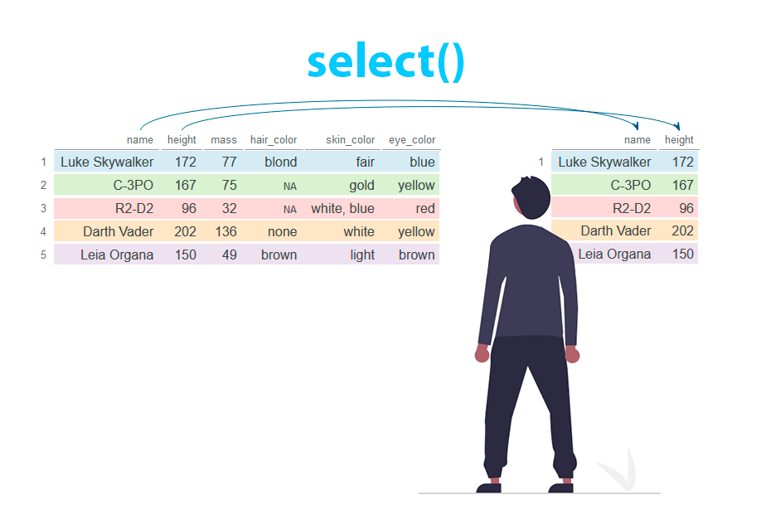
select() and rename()
select() allows us to subset the data by selecting the columns/variables that we’re interested in. As before, the first argument is the tibble, and the subsequent arguments are the variables we wish to select.
# select only date-related variables (year, month, day):
select(flights, year, month, day)
more readable way to work with your data, compared to base R
flights[, c('year', 'month', 'day')]
#select all variables between year and day, inclusive
select(flights, year:day)
# select all variables except date-related variables:
select(flights,-(year:day))
Notes:
select() is for choosing specific columns
— kind of like trimming your table down to just the variables you care about.
CLICK
You still start with your tibble, then list the columns you want.
So select(flights, year, month, day) pulls just those three.
You can also use : to select a range of columns, like year:day, and the minus sign to exclude them.
It’s a cleaner, more readable way to work with your data, especially compared to flights[, c('year', 'month', 'day')] from base R.
And if you want to rename columns while selecting, we can do that too
— we’ll come back to rename() shortly

Slide 63
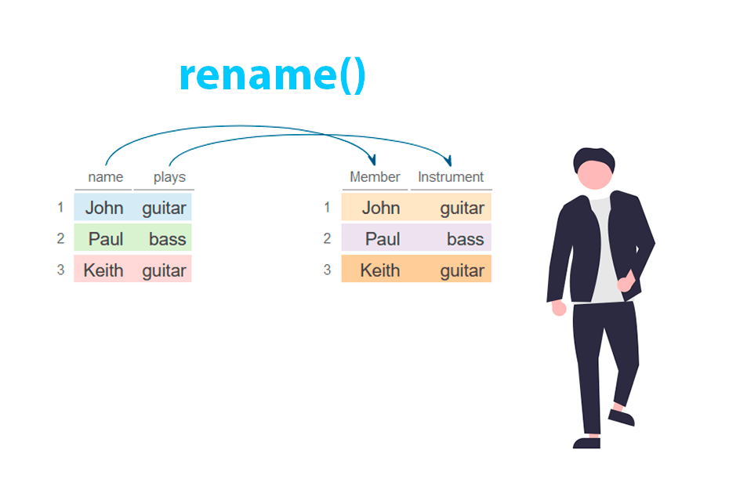
select() and rename()
Can also use select() to rename variables.
Syntax is select(tibble, new.name = oldname).
# E.g., variable name tailnum doesn’t match style of other # variable names, so change it to match style:
select(flights, tail_num = tailnum)
However, doing this produces a tibble with only the variable in question and drops the rest.
# Function rename() renames variables without dropping # the rest. Syntax is the same:
rename(flights, tail_num = tailnum)
Notes:
You can also rename variables with select(),
using this syntax: new_name = old_name.
CLICK
Here we are just selecting tail number
But be careful — select() keeps only the columns you list.
So if you rename one variable with select(), you’ll lose the rest.
If you want to rename without dropping other variables, use rename() instead.
It uses the exact same syntax — just a different function name.
Super handy when you're cleaning up messy column names or standardising styles

Slide 64
distinct()
Helps extract unique values from a variable.
Syntax: distinct(dataset,by=column1)
Shows a tibble with only the unique values of tailnum. If the variable name doesn't match your naming style, change it first:
# Rename the variable
flights_renamed <- rename(flights, tail_num = tailnum)
# Then extract unique values
distinct(flights_renamed, by = tail_num)
Notes:
distinct() is used to extract the unique values from one or more columns.
The basic syntax is distinct(data, column_name)
— and that gives you a tibble with just the distinct values from that column.
This is great for exploring things like all the airlines in a dataset or the different types of planes.
CLICK
You can also combine it with multiple columns to find unique combinations
— for example, distinct airport and airline pairs

Slide 65
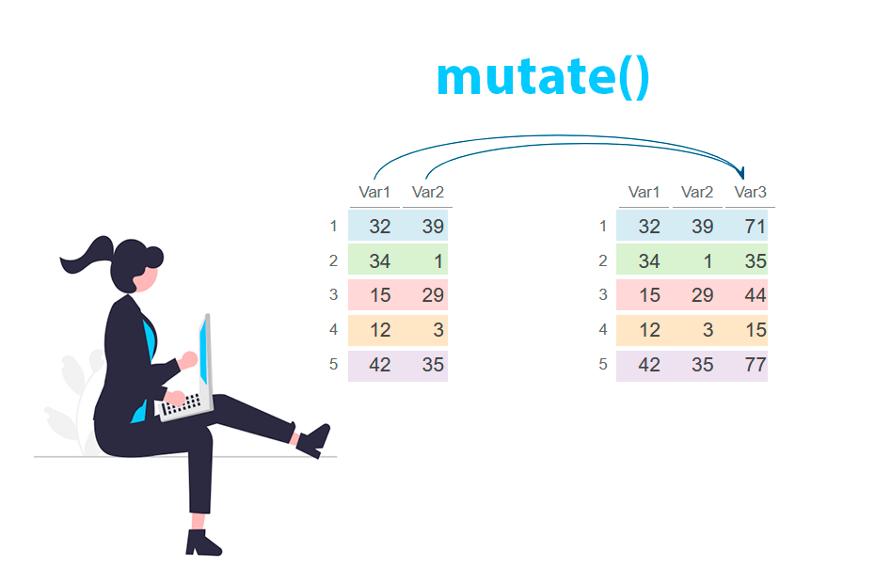
mutate() and transmute()
mutate() adds new columns that are functions of existing columns.
Syntax: mutate(tibble, new_var = func_old_vars)
# E.g., add gain variable that gives amount of time exceeding scheduled time in the # air, and speed variable in mph:
mutate(flights,
gain = arr_delay - dep_delay,
speed = distance/air_time * 60)
Hard to see right? What function could you add to see the data frame?
Subsequent new variables in the same command can refer to previous new variables created.
If you only want to keep the new variables use transmute() with the same syntax.
Notes:
mutate() is used to create new columns based on calculations with existing columns.
The syntax is mutate(data, new_column = some_function_of_existing_columns).
You can add one or more new variables — just separate them with commas.
CLICK
In this example, we add a gain column by subtracting dep_delay from arr_delay,
and a speed column by dividing distance by air time and multiplying by 60 to get mph.
What’s nice is that the second new variable (speed) can use the first one (gain) if you define them in order.
And remember: mutate() keeps all the original columns.
If you only want the new columns in your output, you can use transmute() instead — same syntax, but it drops everything else.

Slide 66
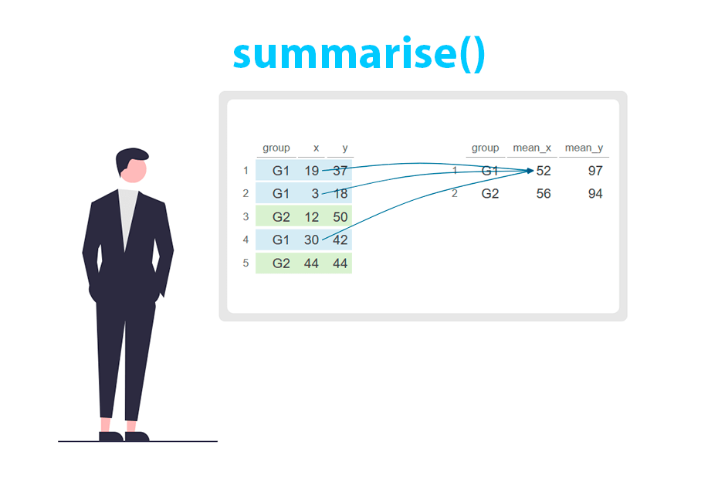
summarise()
Collapses data frames to a single row.
Syntax is summarise(tibble, entry_name=function)
# E.g., determine mean and standard deviation of departure # delay (dep_delay):
summarise(flights,
mean_dep_delay = mean(dep_delay, na.rm=T),
sd_dep_delay = sd(dep_delay, na.rm=T))
Alone this is useless until we touch upon the group_by() function.
Notes:
summarise() collapses your data down — often to a single row — by applying a function to one or more columns.
The syntax is summarise(data, new_column = function(column)).
CLICK
In this example, we’re calculating the mean and standard deviation of dep_delay.
Notice we use na.rm = TRUE to ignore missing values — that’s good practice.
But on its own, summarise() isn’t super useful — it just gives you one overall summary.
To really make it powerful, we’ll combine it with group_by() next, so we can get summaries by group — like by airline, month, or destination.

Slide 67
group_by()
Groups data set into multiple subsets.
Syntax is group_by(tibble, grouping_var).
The resulting tibble includes the grouping variable in the tibble heading with the number of groups.
# E.g., group flights data by tail number (tailnum):
1) by_tailnum <- group_by(flights, tailnum)
2) summarise(by_tailnum,
mean_dep_delay = mean(dep_delay, na.rm=T),
sd_dep_delay = sd(dep_delay, na.rm=T))
Notes:
group_by() is used to split a data frame into subsets based on one or more grouping variables. Syntax: group_by(tibble, grouping_var)
It doesn't change the data but adds grouping structure, which affects how functions like summarise() behave.
After grouping, summaries are calculated separately for each group.
CLICK
In this example, we first group the flights data by tailnum,
which identifies individual planes: by_tailnum <- group_by(flights, tailnum)
Then we use summarise() to calculate the mean and standard deviation
of departure delays for each plane.
Because the data is grouped, summarise() performs these calculations separately within each group.
The output is a new tibble with one row per plane, and columns for the mean and standard deviation of dep_delay.

Slide 68

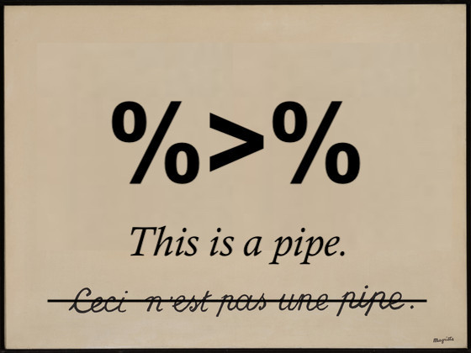
Stringing together multiple dplyr commands… THE POWER OF PIPES
All of these functions work fine on their own. But if we want to string together multiple dplyr commands and result in one tibble, we have to save our objects at each step of the way.
# create a flights tibble that displays only average departure and arrival delays for # days on which either of those averages are greater than 30 minutes:
A1 = group_by(flights, year, month, day)
A2 = select(A1, arr_delay, dep_delay)
A3 = summarise(A2, arr = mean(arr_delay, na.rm = T),
dep = mean(dep_delay, na.rm =T))
A4 = filter(A3, arr > 30 | dep > 30)
Notes:
But doing things like we did on the previous slide can be tedious and make lines and lines of code.
This is were dplyr is king… We can string things together..
CLICK.
SO say we have all if this code.
Can someone tell me what A1 is doing
A2
A3
A4?
Rather than doing all of that this is where the pipe comes in!
CLICK

Slide 69
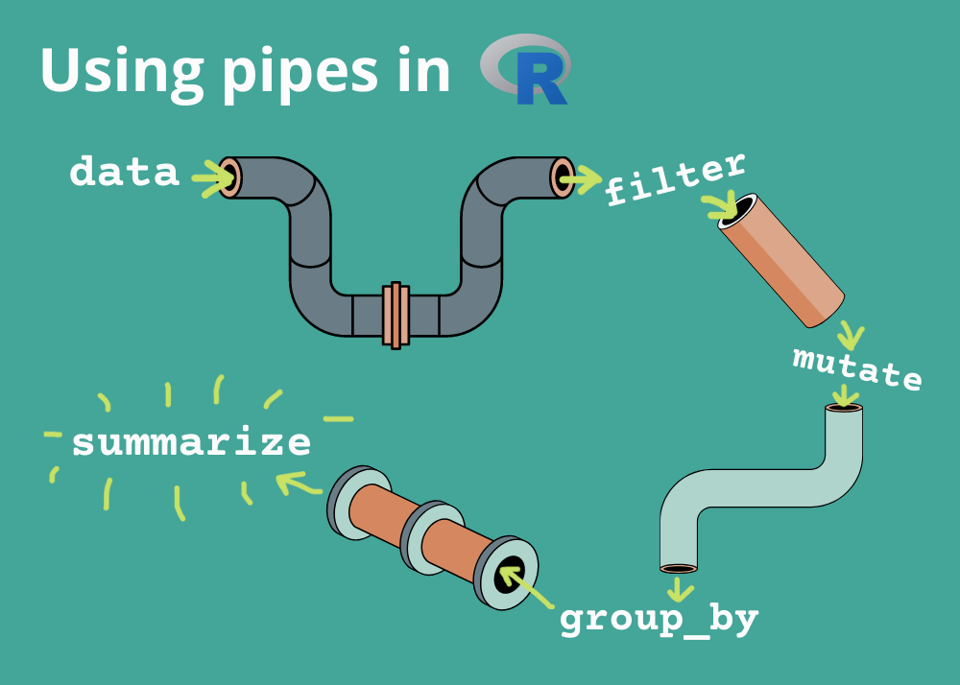
Stringing together multiple dplyr commands… THE POWER OF PIPES
What’s a pipe? A forward‐pipe operator that passes the output of one expression as the first argument to the next.
Why use pipes?
Makes code linear and readable
Eliminates nested function calls
Encourages stepwise data transformation
Key package: %>% comes from magrittr (and is re‐exported by dplyr, tidyverse, etc.)
Notes:
Pipes let us chain together multiple dplyr commands in a clean, readable way.
The pipe operator %>% takes the result of one line of code and passes it as the first argument to the next function.
S
o instead of nesting functions inside each other — which can get confusing — we write code step by step, in the order it’s applied.
This makes our workflow more transparent and easier to debug.
The pipe comes from the magrittr package but is also available when we load dplyr or tidyverse.
We’ll use pipes throughout the rest of the course, so it’s good to get comfortable with them now.

Slide 70
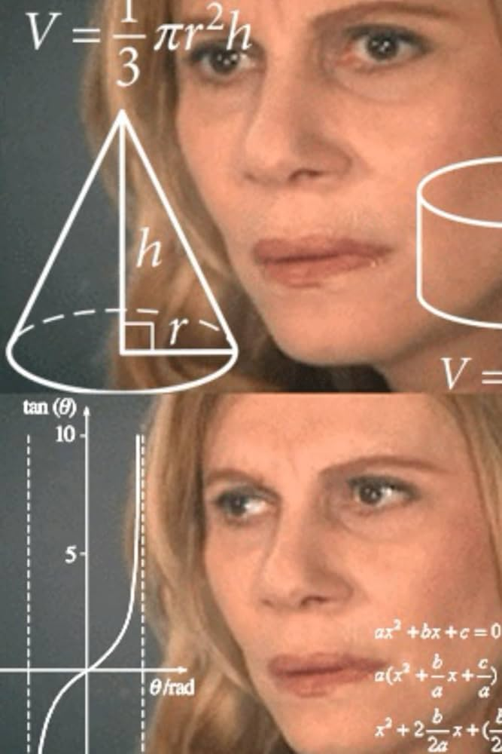
Stringing together multiple dplyr commands… THE POWER OF PIPES
All of these functions work fine on their own. But if we want to string together multiple dplyr commands and result in one tibble, we have to save our objects at each step of the way.
# create a flights tibble that displays only average departure and arrival delays for # days on which either of those averages are greater than 30 minutes:
A1 = group_by(flights, year, month, day)
A2 = select(A1, arr_delay, dep_delay)
A3 = summarise(A2, arr = mean(arr_delay, na.rm = T),
dep = mean(dep_delay, na.rm =T))
A4 = filter(A3, arr > 30 | dep > 30)
This will clutter up your environment

Slide 71
Stringing together multiple dplyr commands
Alternatively, we can write each command within the subsequent command:
# E.g., from the previous slide:
flights %>%
group_by(year, month, day) %>%
select(arr_delay, dep_delay) %>%
summarise(
arr = mean(arr_delay, na.rm = TRUE),
dep = mean(dep_delay, na.rm = TRUE),
.groups = "drop") %>%
filter(arr > 30 | dep > 30)
flights data frame
↓ group_by()
↓ select()
↓ summarize()
↓ filter()
Notes:
Here’s what it looks like when we string together multiple dplyr commands using pipes.
We start with the flights dataset and then: → group the data by year, month, and day, → select just the arrival and departure delays, → summarise those columns to get the mean delay, → and finally filter to show only days where delays were large.
The syntax flows top to bottom — each step builds on the last. This is much more readable than nesting functions and lets us clearly follow the logic of our data transformation.
The .groups = "drop" argument is used here to remove the grouping once we’re done summarising.

Slide 72



Using AI
Think of AI as…
A “calculator for words” – it predicts the next token based on context, so more detail = better result.
A paired programmer – don’t expect perfection up front; break problems into steps, discuss your approach, then iterate.
Iterate & Refine
Share your errors or unexpected outputs
Explain “this is what I got vs. what I expected” to help the AI self-correct
At the end of the day if you don’t know the ‘R language’… Don’t expect AI to solve your problems

Slide 73
Next week…
But first…reminder we have a workshop this week!
Wednesday, 11-1 at PAR125-L1-Room 127 (WEBS)
Next week we will cover:
reading in data
other data wrangling techniques
a guide to cleaning ‘dirty’ data
Applying all of this into Quarto files!
Your coding assignment

